Slide 1
Air Quality Initiatives at Sea-Tac Airport
Leslie Stanton, MS, MBA
Sustainability Manager
Aviation Environmental
July 26, 2017

Slide 2
Overview
Port Air Quality Goals and Priorities
Types and Sources of Air Pollution
Span of control
Pollution Reduction Initiatives
Emerging Science
Impacts of Air Pollution
Next Steps

Slide 3
Executive Summary
Port pursuing aggressive environmental goals
Limited regulatory authority
Innovative programs and initiatives with multiple benefits
Existing studies
Tracking emerging science
Ultrafine particulates (UFPs)
Reductions in PM from climate strategies

Slide 4
Air Goals and Directives
Century Agenda
Reduce air pollutants and carbon emissions, specifically:
Greenhouse gas from Port owned or controlled sources:
15% below 2005 levels by 2020
50% below 2005 levels by 2030 and
carbon neutral by 2050
GHGs where the Port has influence:
50% below 2007 levels by 2030 and
80% below 2007 levels by 2050
Air pollution by 50% by 2034
Notes:
Port CEO provides directives to the divisions to be “the greenest and most efficient port in North America.”
Commission also directs divisions to protect environment in the Century Agenda Goals:
Meet all increased energy needs through conservation and renewable resources.
Reduce air pollutant emisisons by 50% from 2005 levels
Reduce carbon emissions from port-operations by 50% from 2005 levels
Reduce aircraft-related emissions at Sea-Tac by 25%
Meet or exceed agency requirements for storm water leaving Port owned or operated facilities
Sea-Tac Airport Purpose and Strategic Goals
Environmental innovation and environmental leadership as a purpose and stated strategic goal
From those documents, we derive our key programs and objectives in our 5 year strategic plan 2009 - 2014
Includes 7 key performance areas with over 20 objectives for each area
Key areas include air quality/climate protection, energy use and conservation, buildings and infrastructure, solid waste/recycling, water resources and wildlife, noise mitigation, and education and integration (community outreach, stakeholder engagement, etc.)

Slide 5
Types of Air Pollution
Greenhouse gases
Trap heat in our atmosphere
Causes climate change: droughts, flooding, heat waves, loss of snow pack, forest fires, etc.
Regulated Pollutants
NOx, SOx, CO, VOCs
Particulate matter (PM10, PM2.5)
Air toxics
Cause direct adverse health effects in humans
Notes:
GHGs trap heat from the sun in the earths atmosphere. This is a great thing ☺ too much GHGs traps too much heat and the earth warms up and results in changing our climate. GHGs have NO direct impact on human health. Adverse effects come from the increasing temperatures and changing climate. Also, burning fossil fuels have OTHER air pollutants that CAN cause adverse effects in humans.

Slide 6
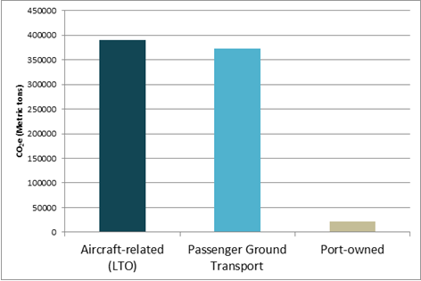
Sources of Greenhouse Gases at Sea-Tac Airport

Slide 7
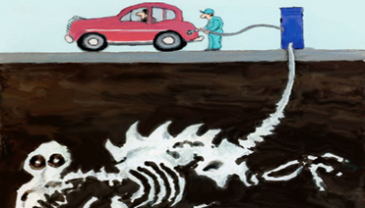
Comparing Sources of Air Pollution at Sea-Tac Airport
PM2.5
Aircraft engines
Ground support equipment
Passenger vehicles
Stationary sources (boilers, diesel generators)
Greenhouse Gases
Aircraft engines
Passenger vehicles
Ground support equipment
Stationary sources

Slide 8
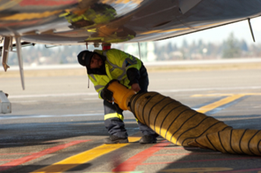
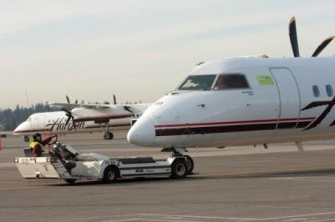
Reducing Aircraft Emissions
Pre-Conditioned air
Saves airlines $13M in fuel
Reduces ~40,000 tonnes GHGs per year
Electric Ground Support Equipment
Installing airport-wide
Reduce ~3,000 tonnes GHGs per year
Gate Improvement Projects
Install gate electrification at all gates
Notes:
Continuing to implement emission reduction projects focused on reducing emissions from our airline partners (SCOPE 3 EMISSIONS!)
Increases in GHGs due to increased electricity needs – 2,000 tons for PC Air, 800 for eGSE

Slide 9
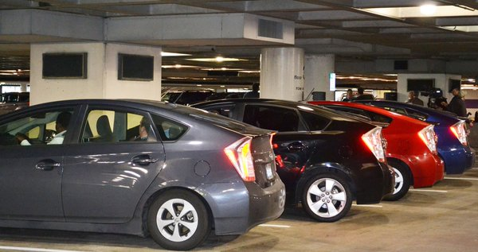
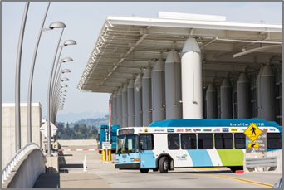
Promoting Clean Vehicles
First US airport to require green taxis
First US airport to require green TNCs in 2016
Converting CNG buses to electric
Adding more electric charging stations
Notes:
CNG/Alternative Fuel Vehicles:
Port’s CNG powered-vehicles at Sea-Tac (29 buses, two sweepers and 60 light-duty vehicles) serve our new LEED certified Rental Car Facility. The new buses reduce air emissions from Port operations. The Port also uses bio-fuels and gas-electric hybrid vehicles at the airport.
Green Taxi Fleet
We’re continuing with our green taxis serving Sea-Tac. As part of a pilot program, 39 hybrid Toyota Prius cabs also were in service. Under the newest (2010) agreement for cab service, cabs will continue to be green—and by 2012 the green cab fleet serving the airport total 210 vehicles.
Electric Charging Stations
Sea-Tac is one of a few airports in the country offering charging stations for electric cars in the airport garage. Regular parking rates apply, but there is no fee for using the electrical connections in this pilot project. There currently are six stalls with this capability, located on the fifth floor of the garage.

Slide 10
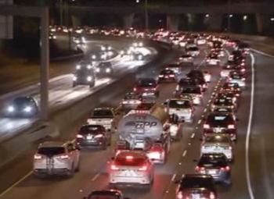
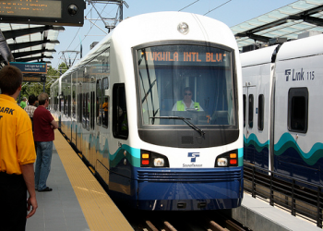
Passenger Vehicles
Ground Transportation Access Plan
Improve access to public transportation
Identify efficient transportation modes
Identify costs and infrastructure changes
What’s future of transportation look like?

Slide 11
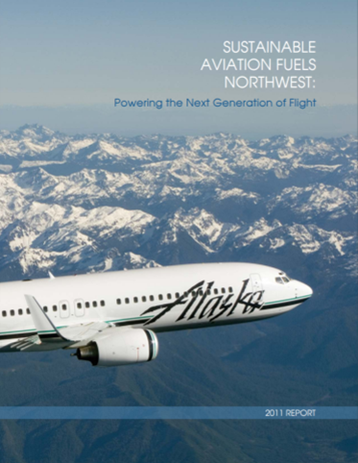
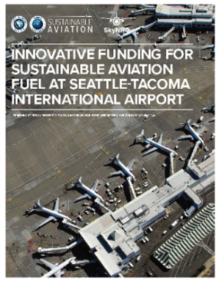
Sea-Tac’s Aviation Biofuel Program
2008-2014
Support research & development
Chart a path to commercial scale biofuels
2015-present
Support fuel integration & infrastructure
Help with incremental cost of fuel
Incentivize biofuel production in WA

Slide 12
Emerging Science: Ultrafine Particles (UFPs)
UFPs penetrate deep into the lungs
Emerging literature suggests health impacts similar to PM2.5
UFP studies at LA and Atlanta airports show UFPs from airports
No clear connection between exposure levels and adverse health impacts
(https://ehp.niehs.nih.gov/1408565/)

Slide 13
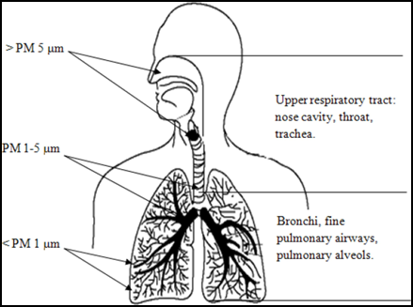
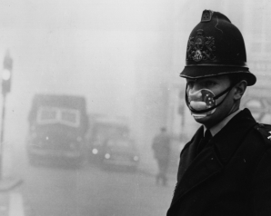
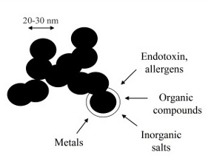
Health Effects of Air Pollution
Air Toxics
Cancer
Respiratory
Particulate Matter
Respiratory and cardiovascular diseases
Increased mortality

Slide 14
Air Quality Studies near Sea-Tac
17 air quality and/or health studies have been conducted near Sea-Tac over the past 40 yrs
None show exceedances of National Ambient Air Quality Standards (NAAQS)
Ambient air contaminants consistent with mobile sources
Sea-Tac Airport contributes less than 5% of NOx to the surrounding area
Health Studies
WA Dept of Health and King County Health Dept analyzed cancer rates from 1985 to 2006 and found an increase in brain cancer in one year only - 1992
Cancer risks from air toxics similar to other urban areas in Seattle and US and largely due to mobile sources and diesel soot.

Slide 15
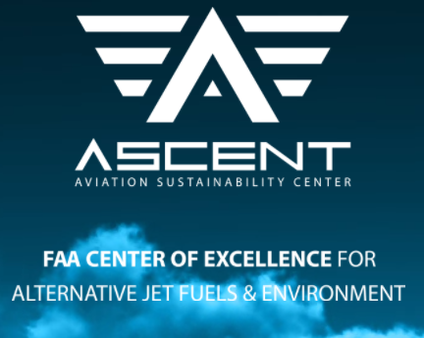
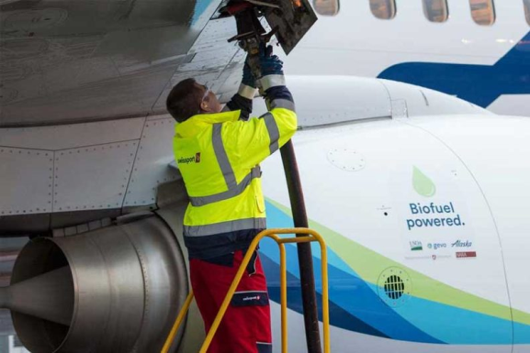
Emerging Science: PM and Biofuels
ASCENT: FAA Center of Excellence for Alternative Jet Fuels & Environment
Research collaborative
Published research since 2015 shows significant reductions in PM from aviation biofuels
Notes:
Includes 6 US universities and USDOT
Reductions vary relative to aircraft engine conditions, biofuel production pathway, and percent blend of biofuel
https://ascent.aero/project/emissions-data-analysis-for-cleen-access-and-other-recent-tests/

Slide 16
Next Steps
Strongly support additional research into exposures and health impacts of UFPs
Includes state-funded UFP health study to be conducted by UW
Continue to implement strategies that reduce GHGs and other air pollutants
Continue to track research on PM reductions from biofuels

