Slide 1
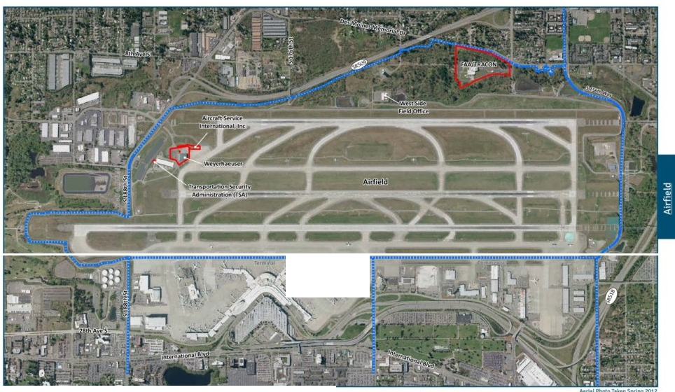
............................
•
0
500 1,000
2.000
Zont Ma tc hUnt 8oundity
PortofSeauleLease Boundary
1 inch • 1,000 fe-et
Fttt
Page 92

Slide 2
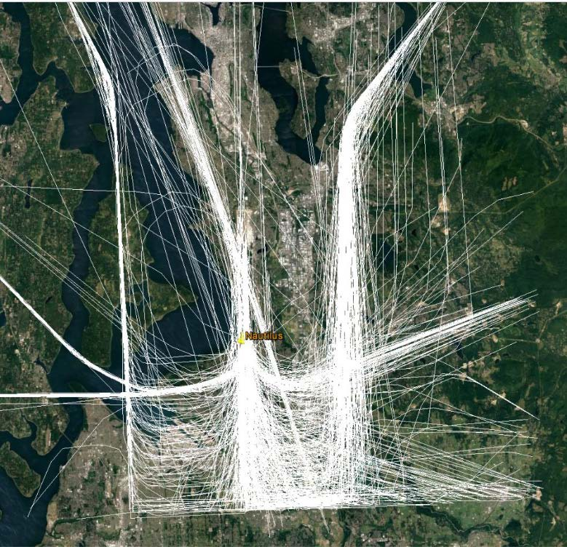

Slide 3
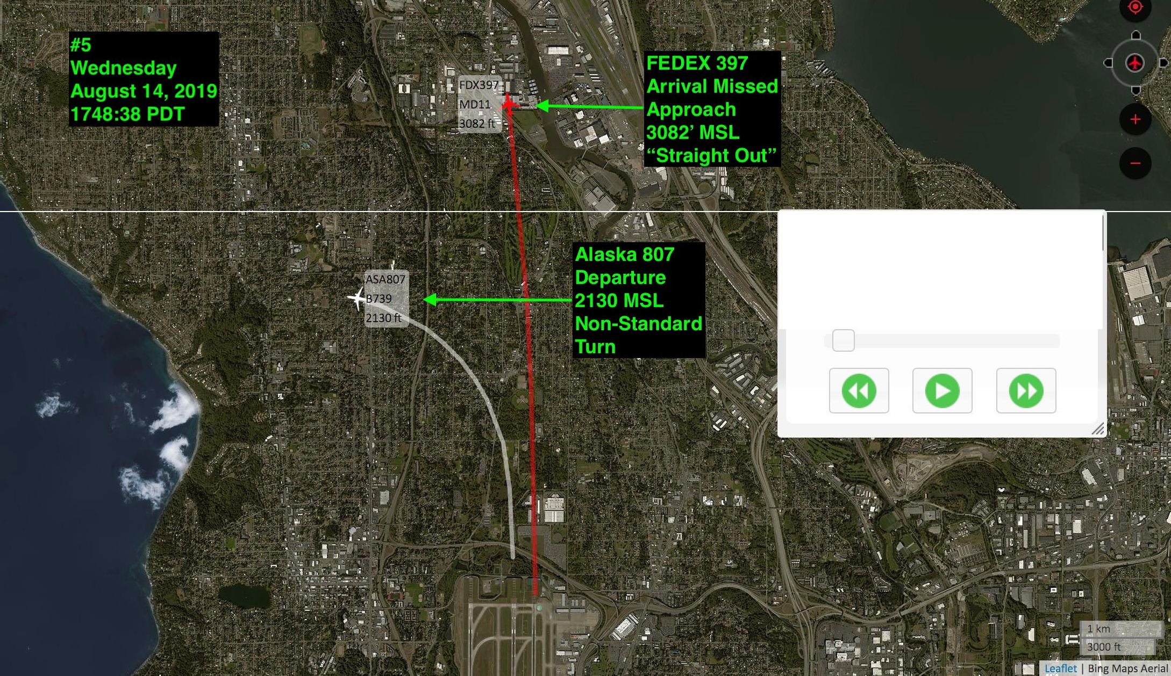
Playback Controls
x
Current time:
Replay speed:
08/14/2019 05:48:38
3x

Slide 4
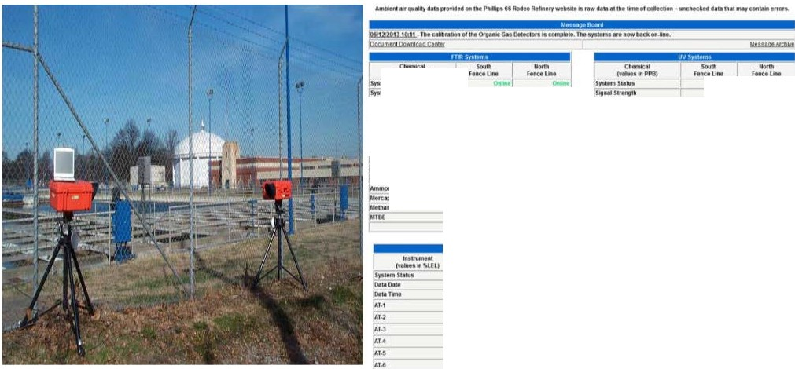
Fenceline monitoring
Automatic Zoom v
IV... IIIPPV,l
........
Dltat•
i lilMIIIM
CWOOIIDltu,._.
0,(Wt
,S.l.llt,ll_lt Dlotllle
n
IM¥XI
l,UMC
, ..-;';':°c:W::;fe- - - , ,,.":. ',=;
DettO.i. Dlltllmt 1.) IIUtldl_,
lc-ttio11)'tSIINIOI
:IO, , c:,c,.-;,,:;i--
- ,. ,:,.0 .11
t$. 11,.A,O_{r}>--
l...
- 1ltOOI
ND
IC)
::t :
,.^{r},
15110
I! tt "ll
lt.- .1.i:,.o1.1MOIOlliH
IJoWH!rllroc.arw. •
ND
-·-
,'.",[
NDI
ND
.,,.,,- - -
ND
ND
ND[
,^{N}.^{D},
.,..^{ll}
lltHI
ND[
20,U,-O,.I.1.1
...
,.,,
,^{N}.^{D},
.tO...C,.D_{r_}tr.
, ' I
Stl)filiffiSM!lte
- 20,>-00 u f
..,...,
ND
.Slo• SC,911911
,, 19:z1f
f11t[
ND[
""
4 fl
w ...
tw,., c-..,.....,,,,.
------ -
--
- r
,O IJ.Ol.17
"'..
'nm,
IS1 11i
, .,, $0
oe
lllfflPIH'-..-.rr1
f
..
H\lf ₋ l!yf ₋
I
fllf
fi.l
r
oO
,o.wPo11111rn
WM tMPHI
r
"
·•
I/MIiiOlf-.clloflhad W..t.NOl'IIIW...,
,._,.
•••·•

Slide 5
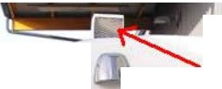
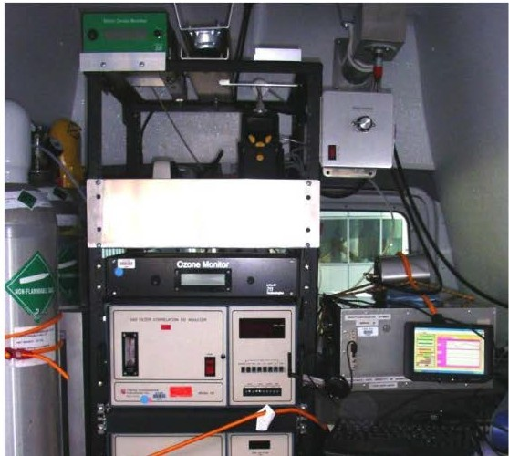
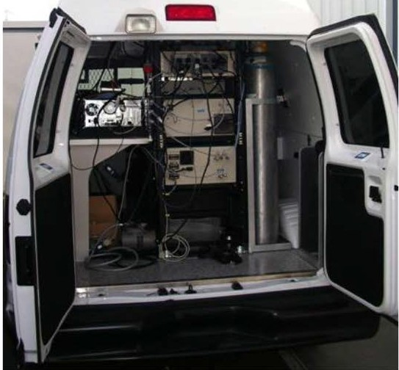
BAAQMD Mobile Monitoring Platform
AIR INLET
-₋-₋₋-·

Slide 6
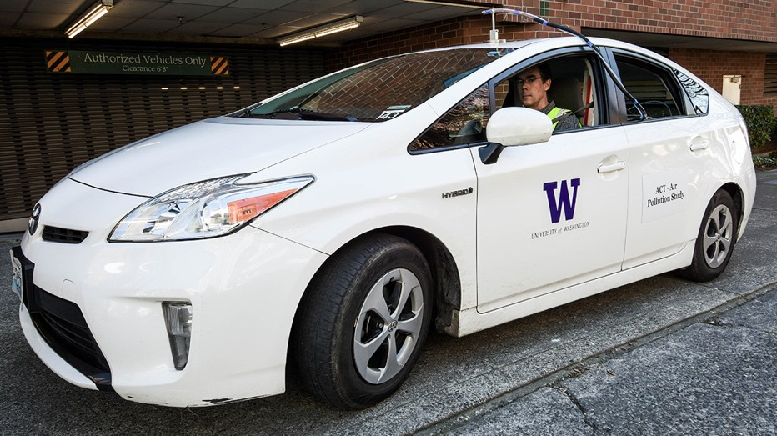
Study Overview
Conducted a mobile monitoring campaign to measure annual-average traffic-related air pollution levels for the ACT cohort
Built UFP prediction models
Characterized exposure for the ACT cohort and the greater Seattle area
Photograph by Sarah Fish, fischs@uw.edu.

Slide 7
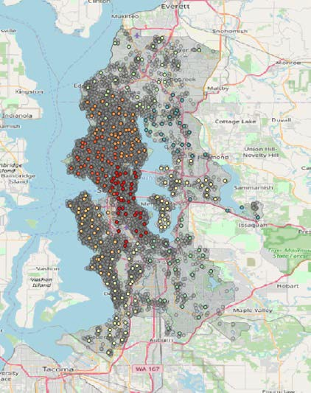
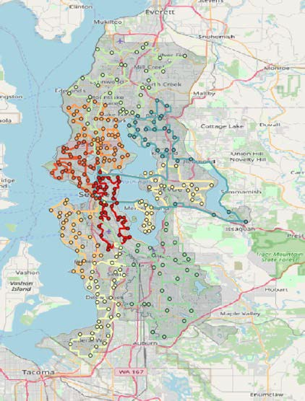
ACT Mobile Monitoring Campaign
309 stop locations representative of ACT cohort (large, geographically diverse area)
9 fixed driving routes
2-min samples per stop
Measured UFPs, BC, PM2.5, CO, CO2, NO2
A driving schedule ensured temporally balanced sampling
Top: Jittered ACT locations and monitoring stops. Bottom: Mobile monitoring routes and stops

Slide 8
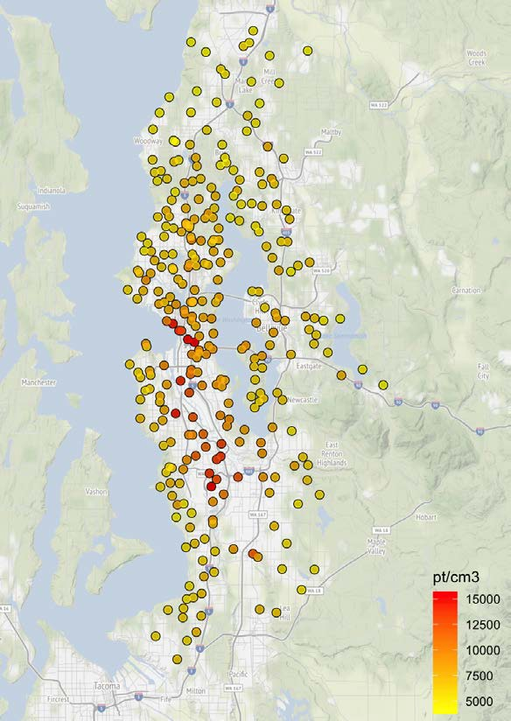
Annual Averages
Collected ~27 samples per site
5 AM – 12 AM
March 2019 – March 2020
>270 drive days
Calculated site annual averages from the ~27 visits
Annual average UFP estimates from mobile monitoring observations.

Slide 9
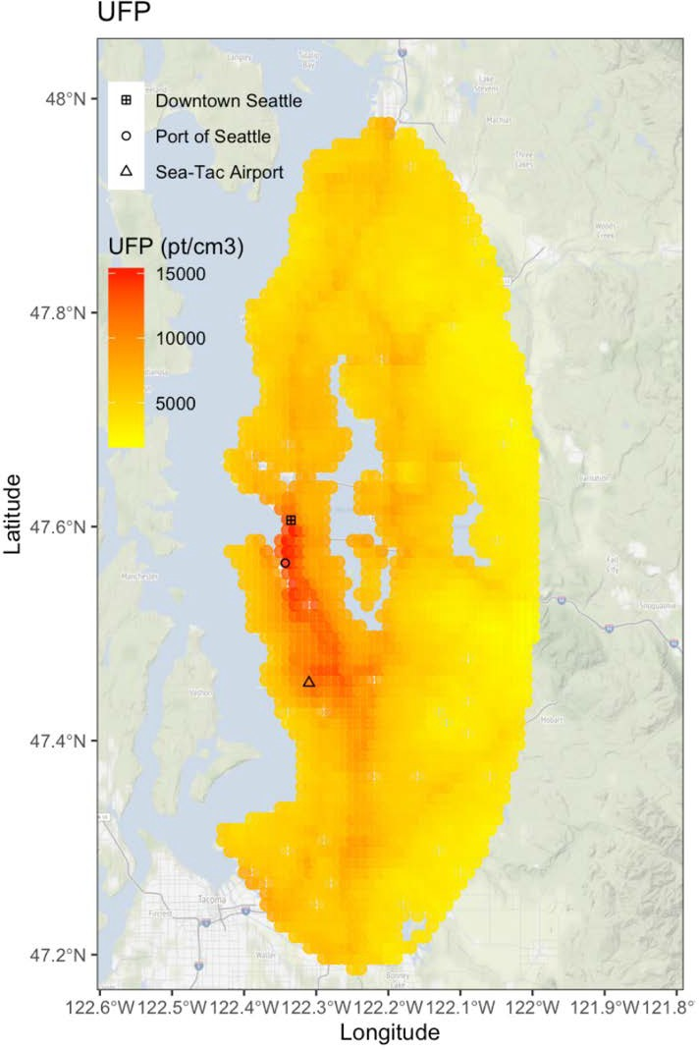
Predicted UFP Map
Spatial distribution of ultrafine particle concentrations in the Puget Sound region.
Pollutants associated with roadway traffic are distributed differently than ultrafine particles.
Nearest PSCAA Regulatory Air Quality Monitor
is in Georgetown, 9.6M from
Sea-Tac Airport runways. (Measures PM 2.5 not aviation)

Slide 10
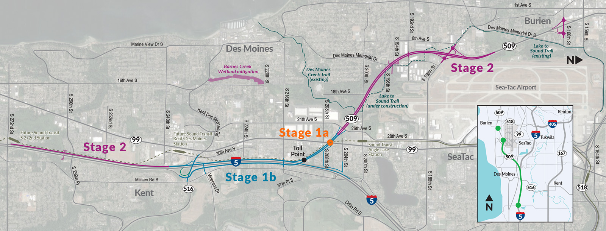
Blueberry Lane

Slide 11
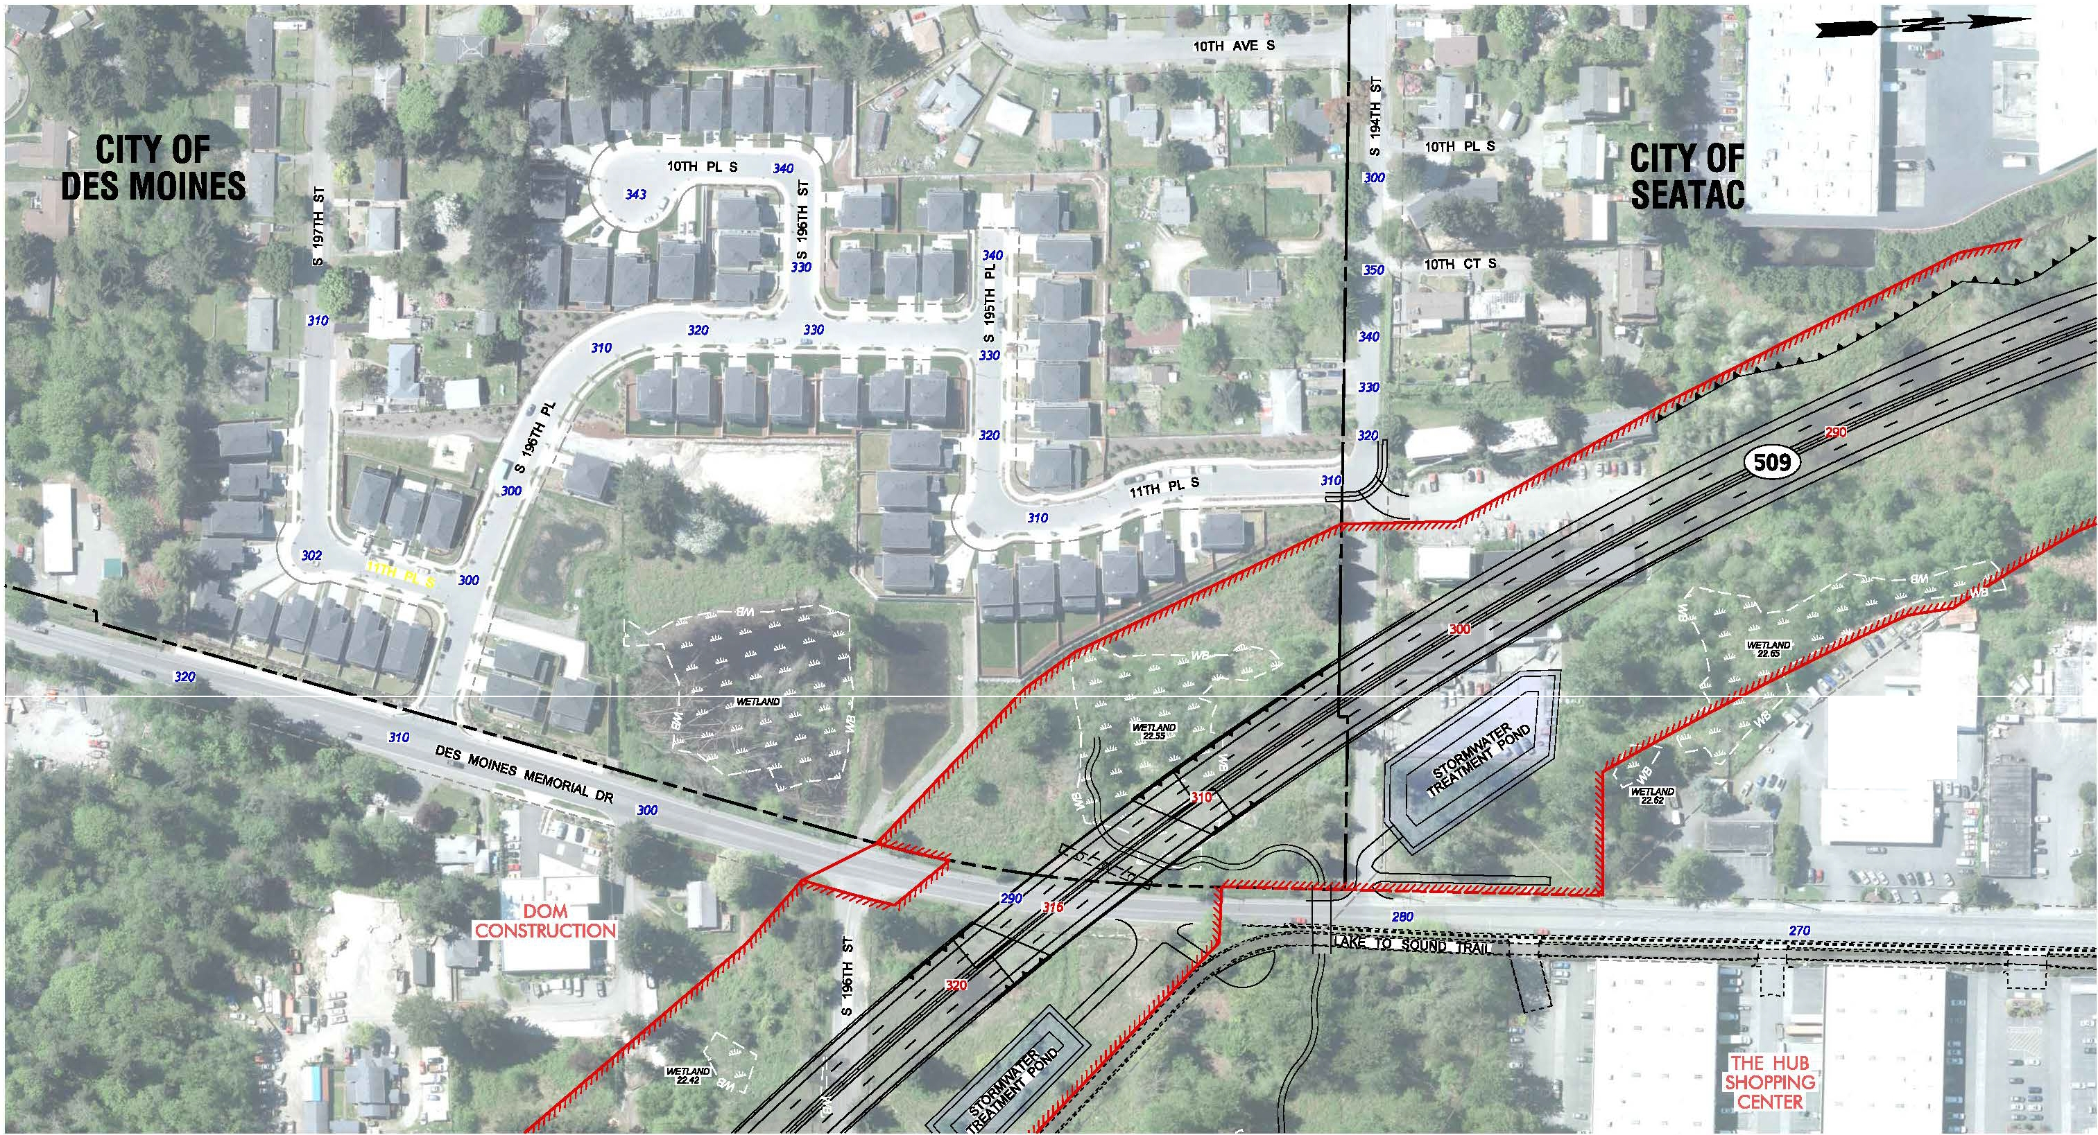
I
SONIC
COLLISIOyN
, ,CENTER
i
IIDI
I?:
Ii
I
Puget Sound
a,, wsoo1
1{
_ !!
GATEWAY Program
--------- v
_1,1c
:!
SR 509124TH AVE S TO S 188TH ST
:: I...
FOR DISCUSSION
NEW EXPRESSWAY PROJECT
L==PU=R=PO=S=ES= =O=NLY====--
B_L U_E_B_E_R_R_Y_LA :_:_:_N=E_N E=l G H=B O R=H O O D=--- J

