Slide 1
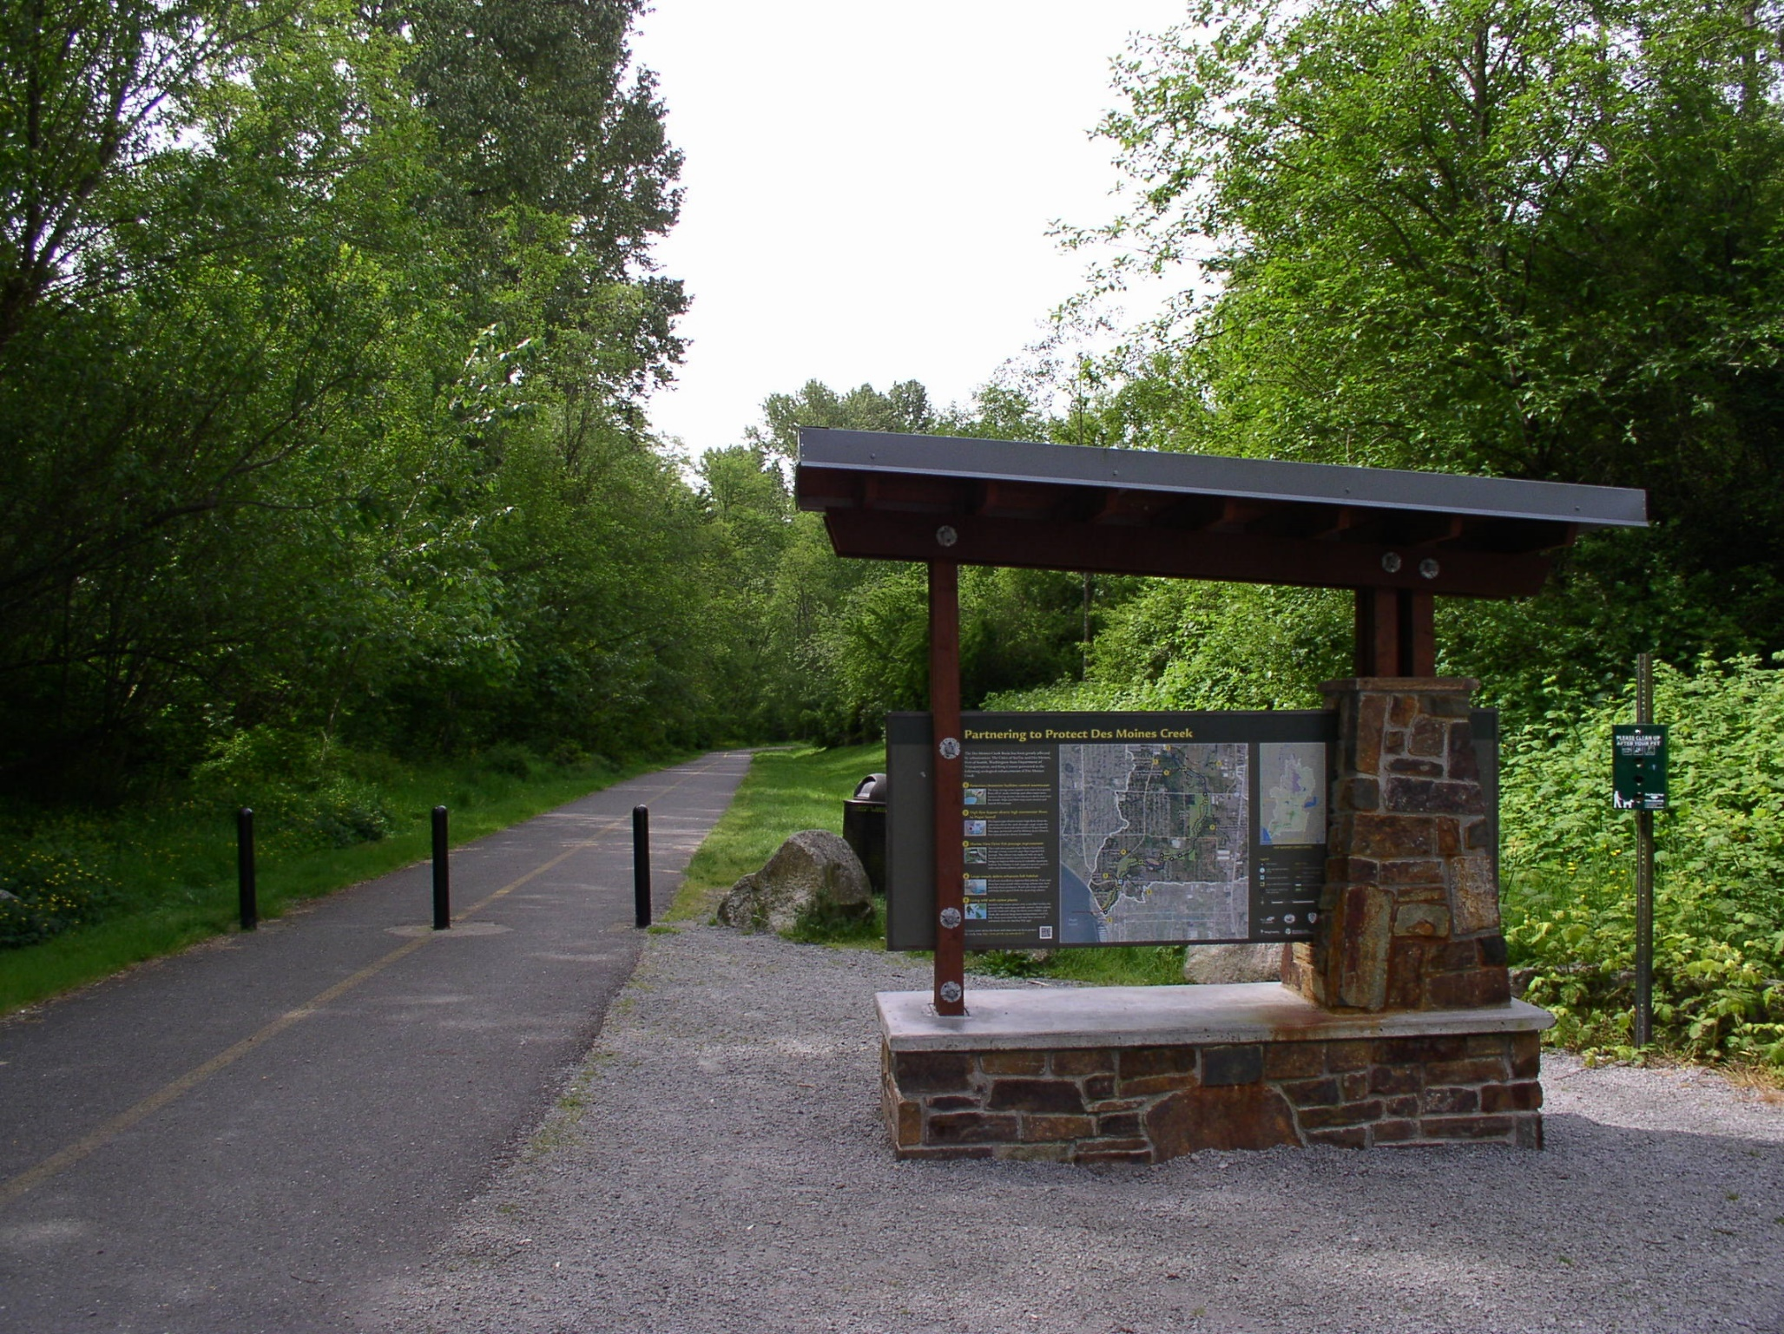
Regular City Council Meeting Des Moines Creek Park
March 9, 2021

Slide 2
PRESENTATION OVERVIEW
PURPOSE OF PRESENTATION
A Motion authorizing the city Manager to execute an amendment to an existing Interlocal Agreement between the City of SeaTac and King County, in order to receive a grant of Conservation Future Tax Levy funds that will be used to acquire property adjacent to Des Moines Creek Park from Washington State Department of Transportation for expansion of the park. .
WHY IS THIS ISSUE IMPORTANT?
Secures additional funding to purchase surplus property from WSDOT.
This Interlocal Agreement will provide $500,00 in grant funding, which will be equally matched by the City, for the acquisition of the property.
Increases opportunities for public access into the park
Opportunity to add 8-acres of forested upland to Des Moines Creek Park and relocate trailhead.
Notes:
Note: Remove all text from this page that is not relevant to your project. Remove descriptions in red.
If you need to add additional text, duplicate this slide to continue your list.
HEADER TITLE ALL CAPS AT FONT SIZE 20 CALIBRI (BODY), BOLD
Insert text at font size 18 Calibri (Body)

Slide 3
BACKGROUND
Since 2018, the City of SeaTac has expressed an interest in acquiring approximately 8-acres of forested WSDOT surplus land adjacent to Des Moines Creek Park.
Expands open space to allow for an improved trail system.
New trailhead to include education and outreach elements, recreation amenities, safer ingress and egress and expand capacity.
Preserves high value conservation property adjacent to one of the City’s salmon bearing streams.
Listed in PROS Plan to increase recreation opportunities and trails.
Notes:
Note: Remove all text from this page that is not relevant to your project. Remove descriptions in red.
If you need to add additional text, duplicate this slide to continue your list.
HEADER TITLE ALL CAPS AT FONT SIZE 20 CALIBRI (BODY), BOLD
Insert text at font size 18 Calibri (Body)

Slide 4
BACKGROUND
In 2019, City Council authorized staff to pursue grant funding opportunities.
Continue formalized discussion with WSDOT regarding the acquisition of the subject property.
Secured $3.29M to date for acquisition purposes.
Additional $1.1M to be decided in 2021 if awarded through Conservation Future Tax Levy grant.
Notes:
Note: Remove all text from this page that is not relevant to your project. Remove descriptions in red.
If you need to add additional text, duplicate this slide to continue your list.
HEADER TITLE ALL CAPS AT FONT SIZE 20 CALIBRI (BODY), BOLD
Insert text at font size 18 Calibri (Body)

Slide 5
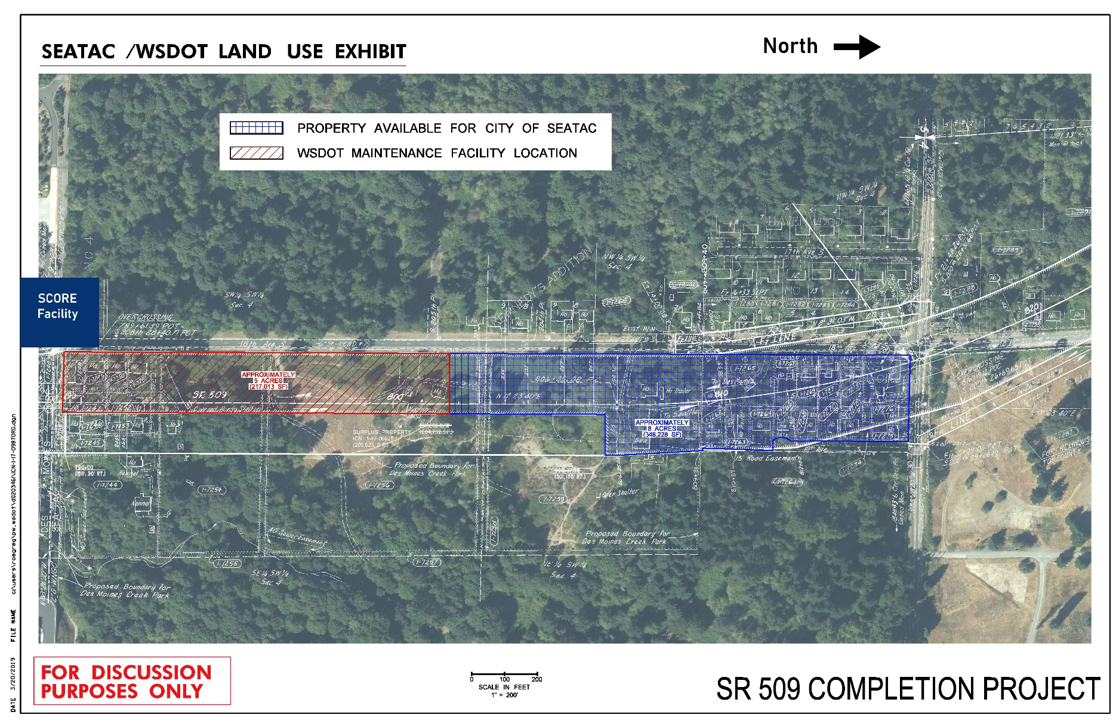
MAP OF PROPERTY
18th Avenue S.
S. 200th Street
Notes:
Note: Remove all text from this page that is not relevant to your project. Remove descriptions in red.
If you need to add additional text, duplicate this slide to continue your list.
HEADER TITLE ALL CAPS AT FONT SIZE 20 CALIBRI (BODY), BOLD
Insert text at font size 18 Calibri (Body)

Slide 6
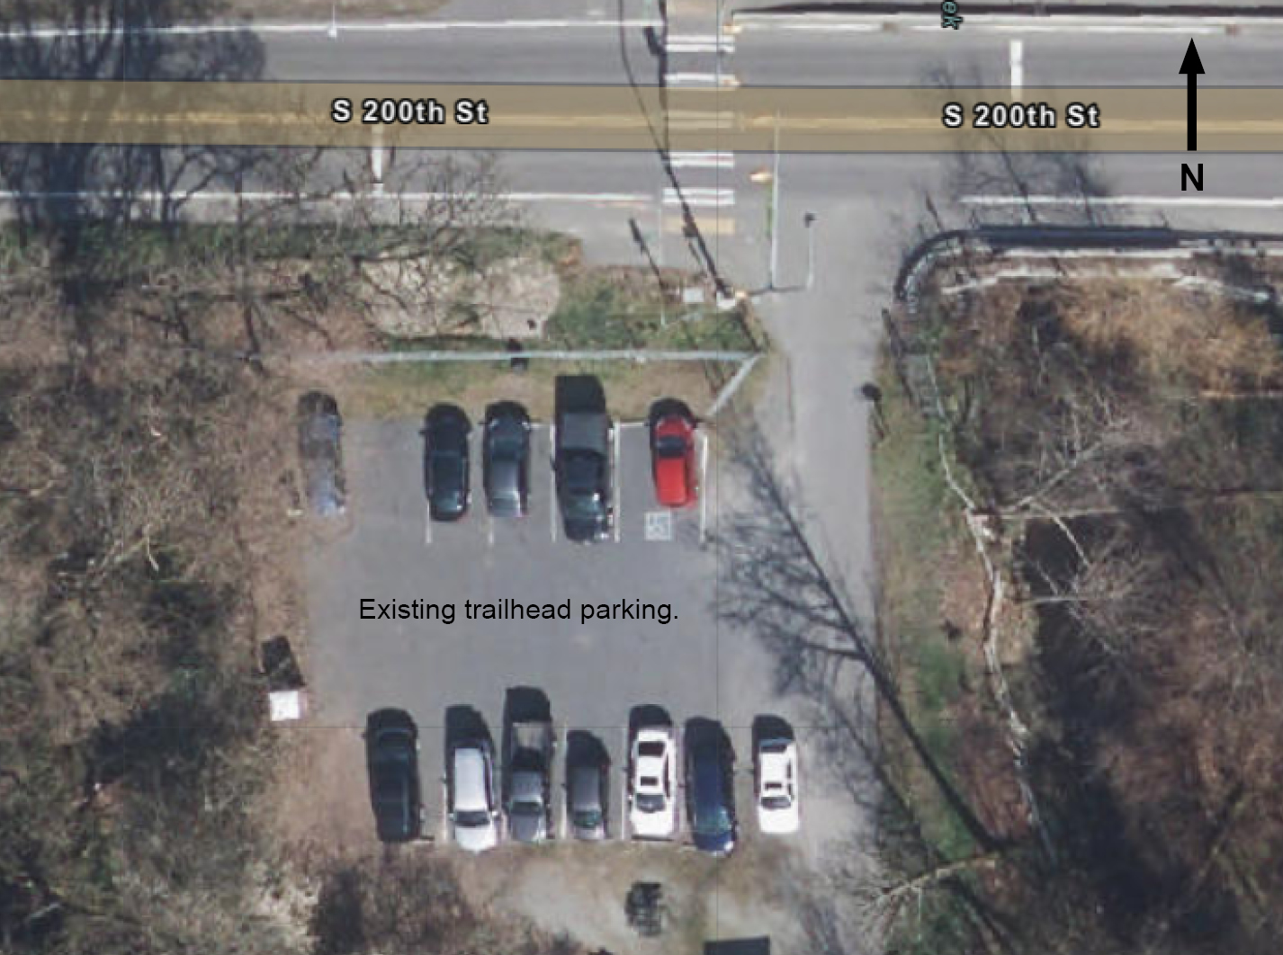
EXISTING TRAILHEAD
Notes:
Note: Remove all text from this page that is not relevant to your project. Remove descriptions in red.
If you need to add additional text, duplicate this slide to continue your list.
HEADER TITLE ALL CAPS AT FONT SIZE 20 CALIBRI (BODY), BOLD
Insert text at font size 18 Calibri (Body)

Slide 7
CURRENT FUNDING SOURCES
2019 King County Conservation Futures Grant | $1.1 M
City Matching Requirement | $1.1 M (403 Fund)
Proceeds from sales of Conservation Property | $90,000
2020 King Conservation Futures Grant | $0.5 M
City Matching Requirement | $0.5 M
TOTAL FUNDING | $3.29M
A third party, independent appraised value at $5.2M to $5.8M ($15-$16.50 per sqft) with the proposed purchase price of $5.5M ($15.79 per sqft) .
Notes:
Note: Remove all text from this page that is not relevant to your project. Remove descriptions in red.
If you need to add additional text, duplicate this slide to continue your list.
HEADER TITLE ALL CAPS AT FONT SIZE 20 CALIBRI (BODY), BOLD
Insert text at font size 18 Calibri (Body)

Slide 8
Funding Summary
Funding Source | 2020 | 2021 | 2022 | Totals
KCCF Grant | $1,100,000 | $500,000 | $1,105,000 | $2,705,000
City (403) | $1,100,000 |  |  | $1,100,000
City (301) |  | $500,000 | $1,105,000 | $1,605,000
City (Property Sales) | $90,000 |  |  | $90,000
Annual Payment | $2,290,000 | $1,000,000 | $2,210,000 | $5,500,000*
Notes:
Remove red text

Slide 9
STAFF RECOMMENDATION
Opportunity to add 8-acres of forested upland to Des Moines Creek Park;
Benefit residents and visitors to the park;
Preserve valuable habitat adjacent to one of our salmon bearing streams; and
Continue to secure Grants through King County Conservation Futures Tax Levy.
Notes:
Note: Remove all text from this page that is not relevant to your project. Remove descriptions in red.
If you need to add additional text, duplicate this slide to continue your list.
HEADER TITLE ALL CAPS AT FONT SIZE 20 CALIBRI (BODY), BOLD
Insert text at font size 18 Calibri (Body)

Slide 10
COMMITTEE REVIEW AND RECOMMENDATION
This item was presented at the Parks and Recreation Committee on March4 and the item was recommended to move forward to the City Council.
Notes:
Note: Remove all text from this page that is not relevant to your project. Remove descriptions in red.
If you need to add additional text, duplicate this slide to continue your list.
HEADER TITLE ALL CAPS AT FONT SIZE 20 CALIBRI (BODY), BOLD
Insert text at font size 18 Calibri (Body)

Slide 11
Questions?
Notes:
Note: Remove all text from this page that is not relevant to your project. Remove descriptions in red.
If you need to add additional text, duplicate this slide to continue your list.
HEADER TITLE ALL CAPS AT FONT SIZE 20 CALIBRI (BODY), BOLD
Insert text at font size 18 Calibri (Body)

