Slide 1
Ambient Ultrafine Particles
Near Sea-Tac Airport
Timothy Larson, Edmund Seto, Elena Austin, Timothy Gould, Michael Yost
University of Washington, Seattle
Presentation to the Federal Way Transportation & Planning Commission
April 1, 2019

Slide 2
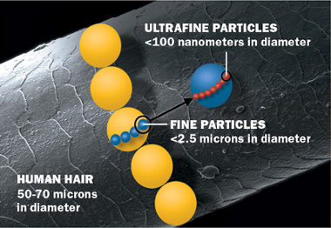

Slide 3
Ultrafine Particles (UFPs)
Ultrafine Particles unregulated but potentially important
Health Effects more uncertain compared to PM_{2.5} ,but a growing body of evidence
Diesel Engines emit ultrafine particles resulting in elevated levels near major roadways (within 200 meters downwind)
Jet aircraft emissions emit “ultra-ultra fine” particles (< 30 nanometers)

Slide 4
Occupational exposures to UFP are known to be high in some settings.
A map of personal exposure concentrations for workers at the Copenhagen airport in Autumn of 2012 is shown at right.
Moller et al (2014) PLoS ONE 9(9): e106671, doi:10.137/journal.pone.006671

Slide 5
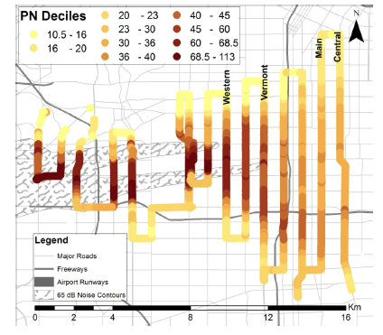
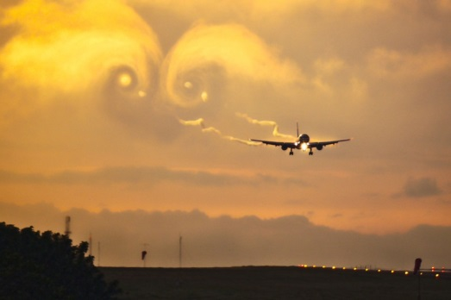
“Ultra-Ultrafine” Particles
10³/cc
Particle size between ~10 and 30 nm diameter are still present at high concentrations at ground level
at 16 km downwind
Hudda et al, ES&T 2014; Hudda and Fruin, ES&T 2016

Slide 6
A selection of cities with published studies of airport UFP impacts
Distance from airport to monitoring site
< 1km | 1 to 10 km | > 10 km
Tianjin, China | London, England | Los Angeles, CA
Rome, Italy | Los Angeles, CA | Amsterdam, NL
Venice, Italy | Norwich, England | Atlanta, GA
Taipei, Taiwan | Boston, MA | New York, NY*
Oakland, CA | Warwick, RI
Santa Monica, CA
*La Guardia

Slide 7
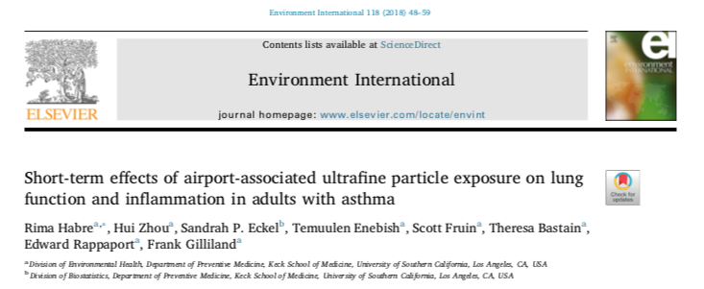
Randomized crossover study of 22 non-smoking adults with mild to moderate asthma
2-hr scripted, mild walking activity both inside and outside of the high LAX UFP impact zone (avg. difference ~30,000 /cc)
Mean particle size at LAX impact zone was 29 nm
“We found significant increases in markers of systemic inflammation associated with ‘Airport UFPs’ and ‘Traffic’ exposure

Slide 8
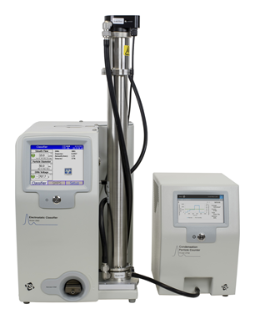
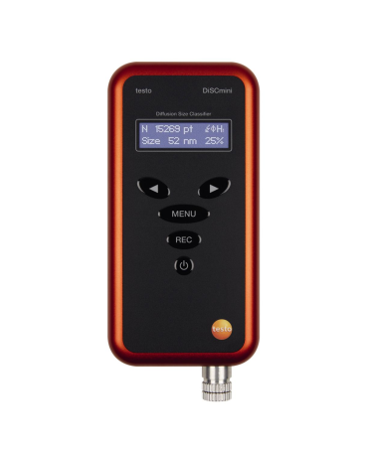
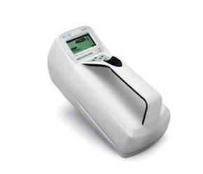
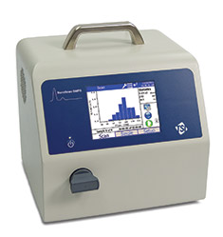
UFP Monitoring Instruments
Increasing Reliability & Cost
DiSC mini
Electrostatic
10 nm – 300 nm
Average size & total count
1 second readings
Condensation Particle Counter
Alcohol-based CPC
> 7nm total count
No Sizing
1 second readings
Nanoscan
Alcohol-based CPC
Electrostatic Sizing
10nm – 300 nm
16 size bins
1-minute readings
Scanning Mobility Particle Sizer
Water-based CPC
Electrostatic Sizing
2nm – 1000 nm
>100 size bins
15 second readings

Slide 9
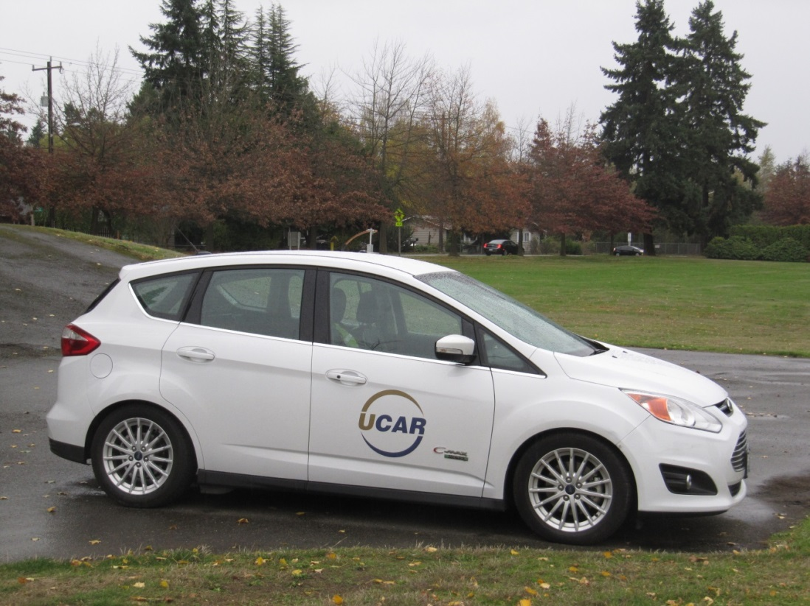
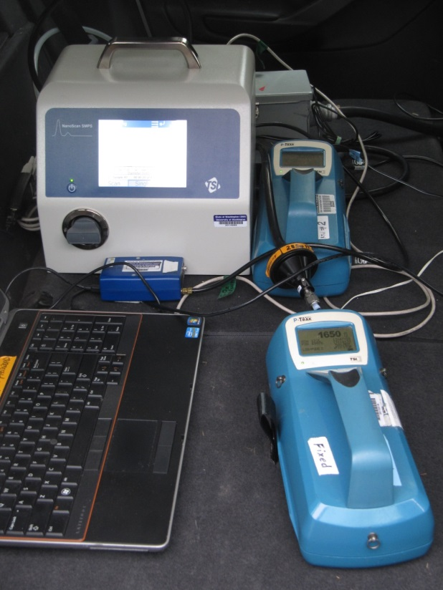
MOV-UP Study
Mobile ObserVations of Ultrafine Particles (MOV-UP) Study

Slide 10
Instruments used in mobile and fixed location sampling
Parameter | Instrument
Particle number concentration (10 nm – 1 µm) | Condensation Particle Counter 3007
Particle size distribution, 13 bins | NanoScan 3910
Black Carbon PM | Micro-Aethalometer AE51
CO₂ | LI-820 Gas Analyzer
Position & Time tracking | GPS Receiver DG-500

Slide 11
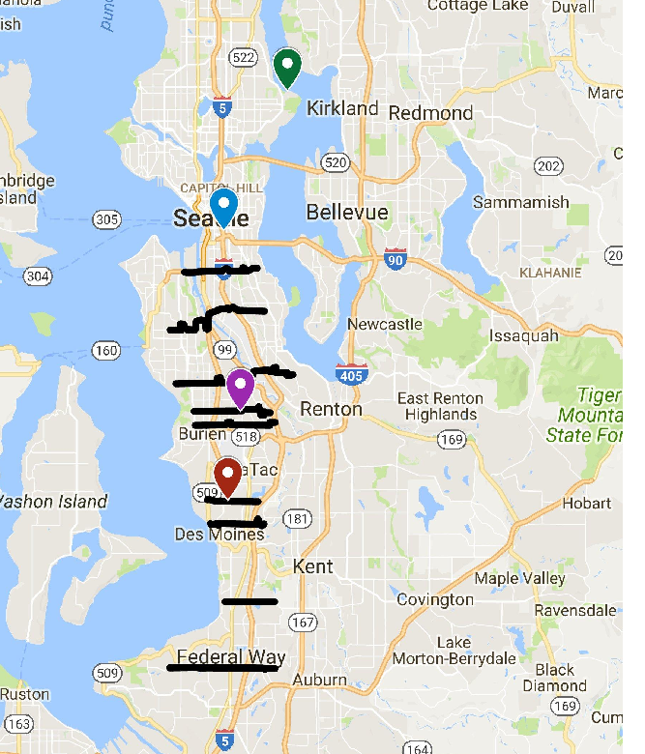
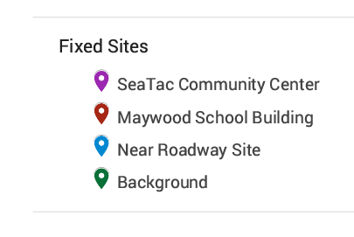
Study Region and Fixed
Monitoring Site Locations

Slide 12
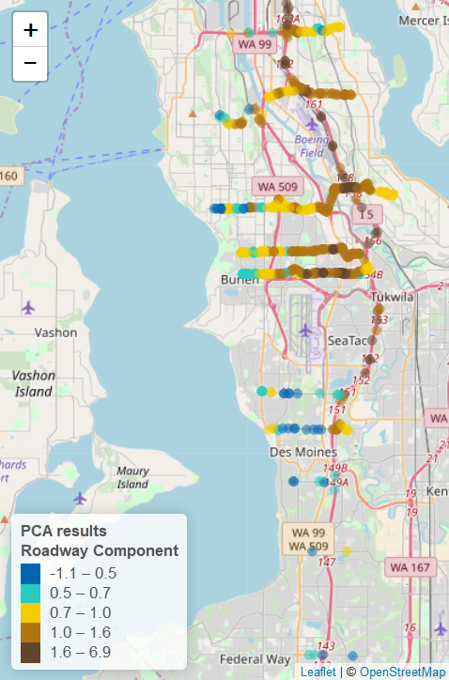
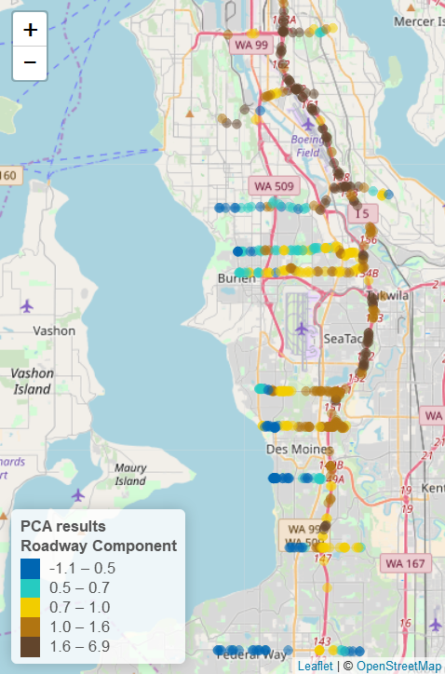


“Roadway” Feature
Wind from the SOUTH
Wind from the NORTH
Winter – Spring Data
Notes:
Add airplane and wind

Slide 13
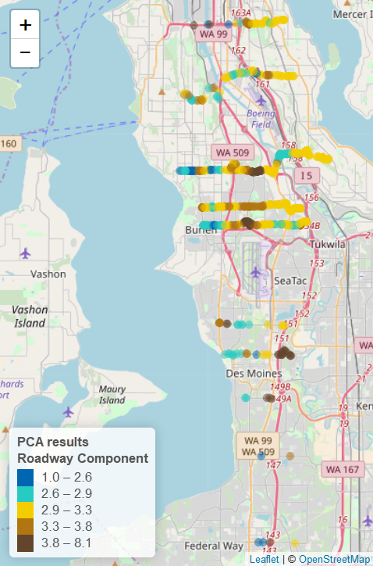
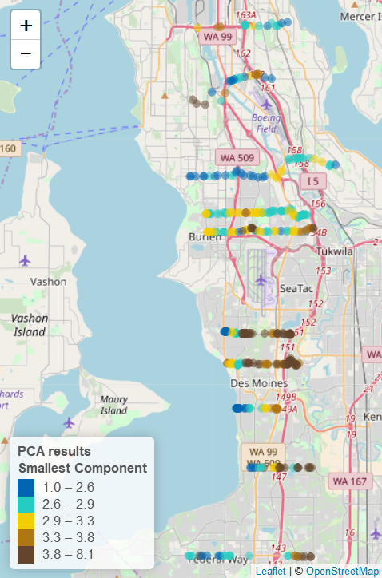
“Ultra-UFP” Feature
Wind from the SOUTH
Wind from the NORTH
Winter – Spring Data
Notes:
Difference of ratios? Add roadway

Slide 14
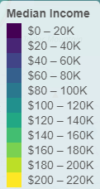
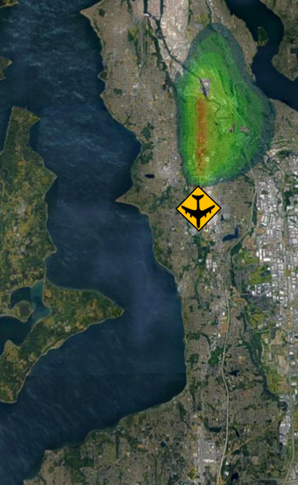
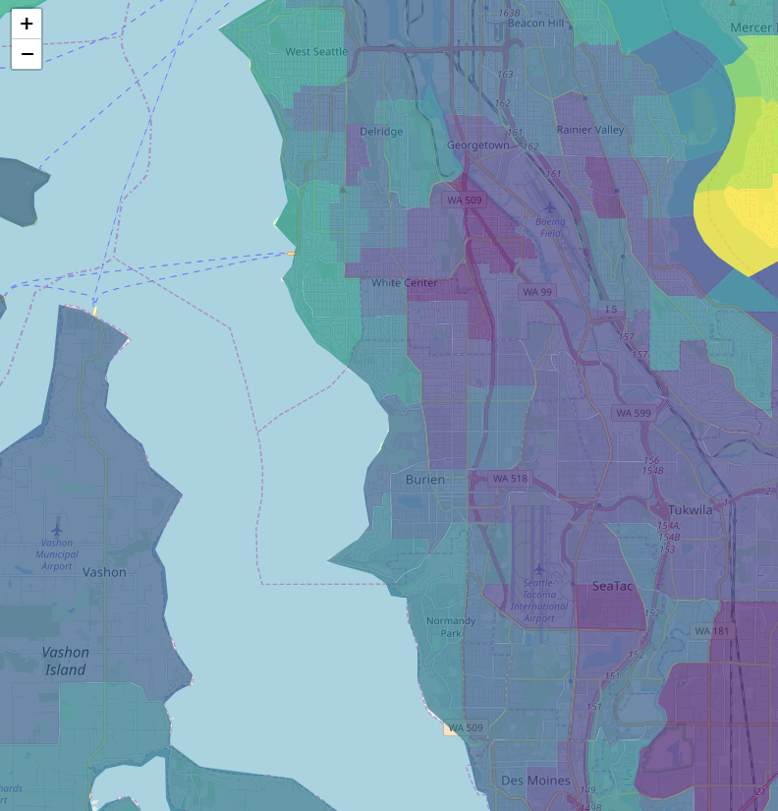
“Ultra-UF” Feature
Winds from the SOUTH
Observed*
Predicted*
Median Income
*Average of all hours during daytime sampling periods
**Average over all hours on all sampling days

Slide 15
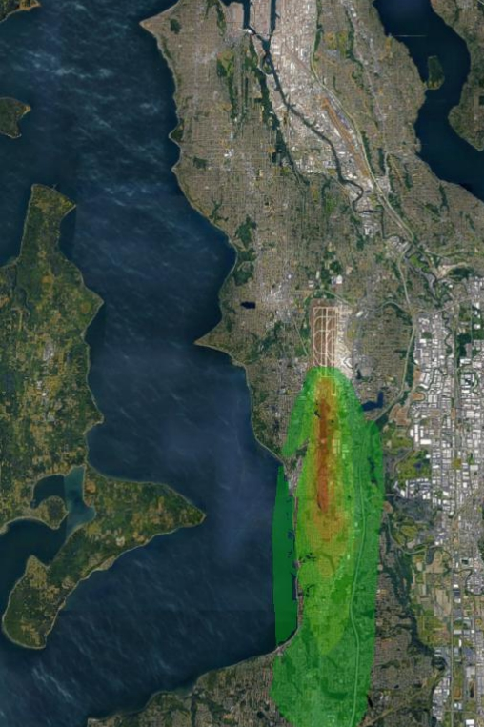
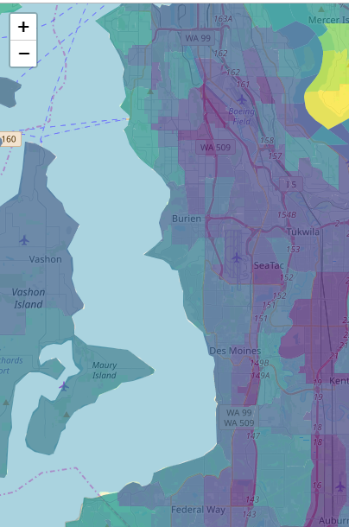
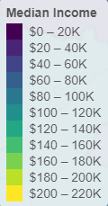
“Ultra-UF” Feature
Winds from the NORTH
Observed *
Predicted **
Median Income
*Average of all hours during daytime sampling periods
**Average over all hours on all sampling days

Slide 16
Monitoring Locations: Schools
Scientifically Relevant (in or out of plume?)
Relevant to Communities
Long-term Availability
Adequate infrastructure
  Power
  Space
  Security
  Ease of access for operating instruments

Slide 17
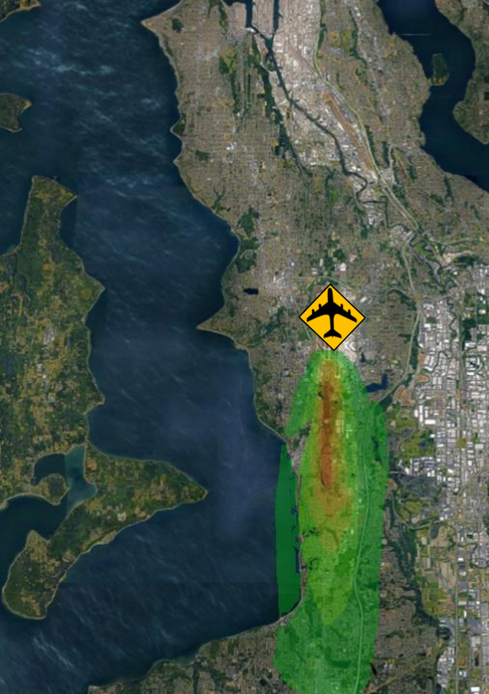
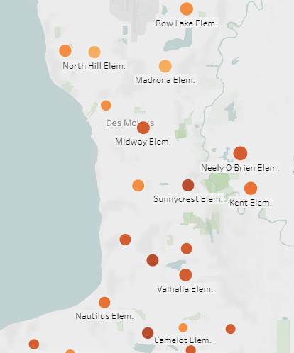
Monitoring Locations: Schools

Slide 18
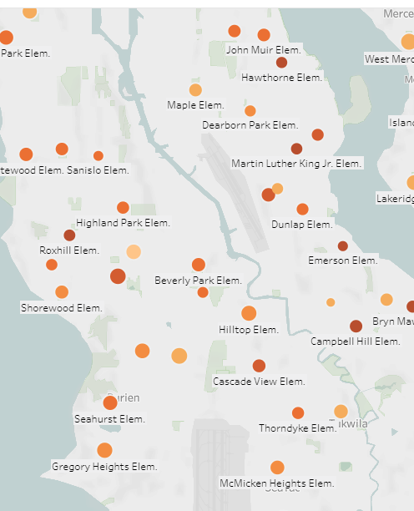
Monitoring Locations: Schools

Slide 19
Summary
Ultrafine Particles (UFPs) are observed near busy roadways and also up to ~10-15 km downwind of SeaTac Airport
Additional monitoring is needed to support health impact studies near the airport
Predictions from a standard atmospheric dispersion model can help to design a UPF monitoring network near the airport
Public schools are good candidates for UFP monitoring sites

Slide 20
Questions?

Slide 22
Supplemental Slides
(if questions arise)

Slide 23
New Beacon Hill Study
Select at least one site in Beacon Hill for simultaneous ultrafine particle (UFP) and noise sampling.
Set up an “anchor site” for comparison that we know is impacted by aircraft UFP and noise.
Run both sites simultaneously so that we can make comparisons for different flight characteristics (traffic, time of day, etc.)

Slide 24
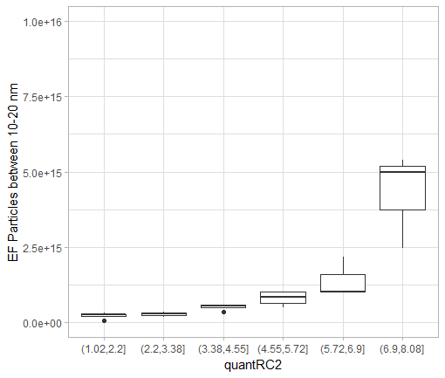
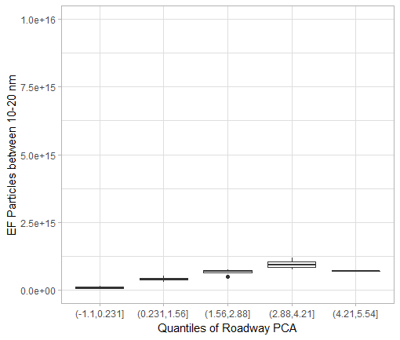
Emission Factors
# Particles/[CO2]_{mass}
Quantiles of PCA (Ultra-UF)
Quantiles of PCA (Roadway)
Winter – Spring Data
Notes:
Add emission by quintile of propSmall

Slide 25
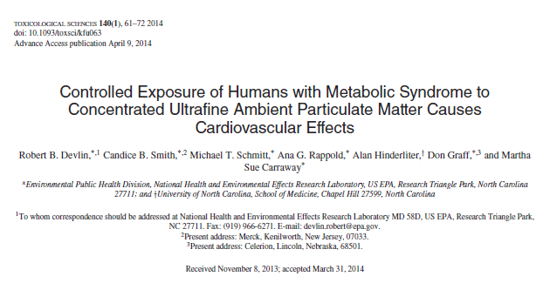
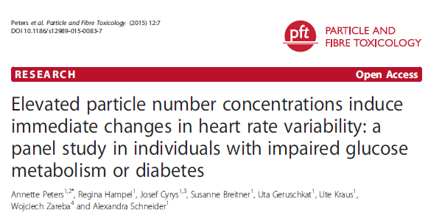
Recent Studies Suggesting Acute Health Effects in Susceptible Populations
Controlled Exposures to Concentrated Ambient Particles
Exposures Documented with Personal Monitors

Slide 26
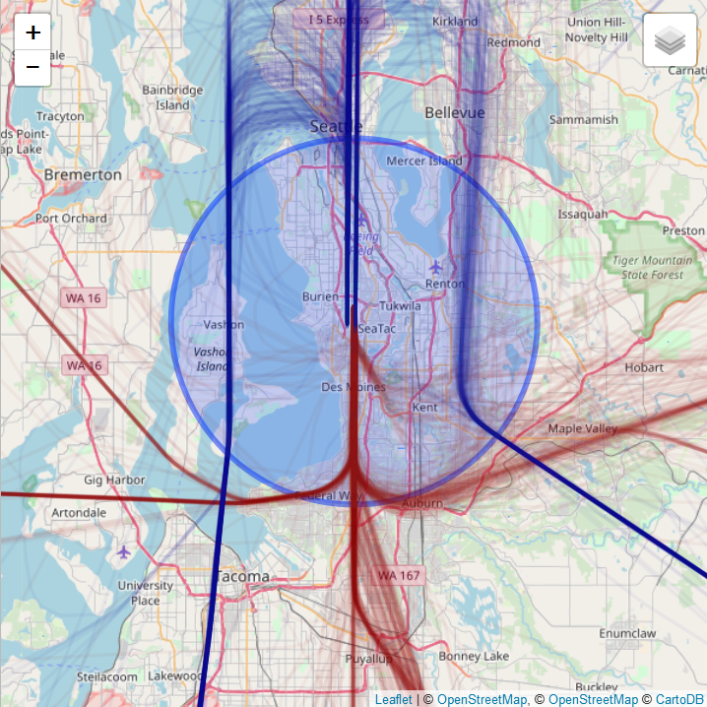
Southerly Winds
Wind
(majority)
Aircraft

Slide 27
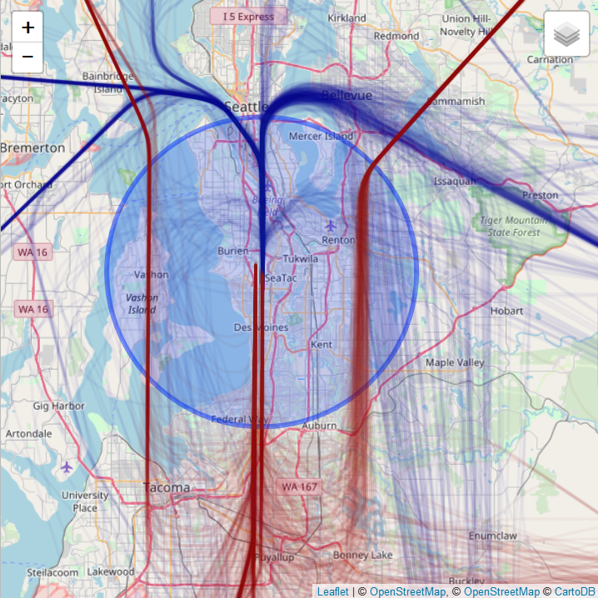
Northerly Winds
Wind
Aircraft

Slide 28
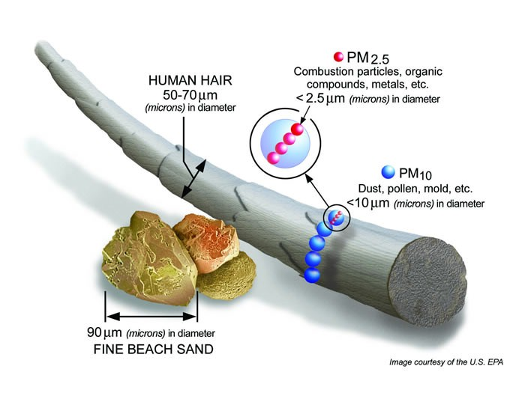
“Fine” Particles

Slide 29
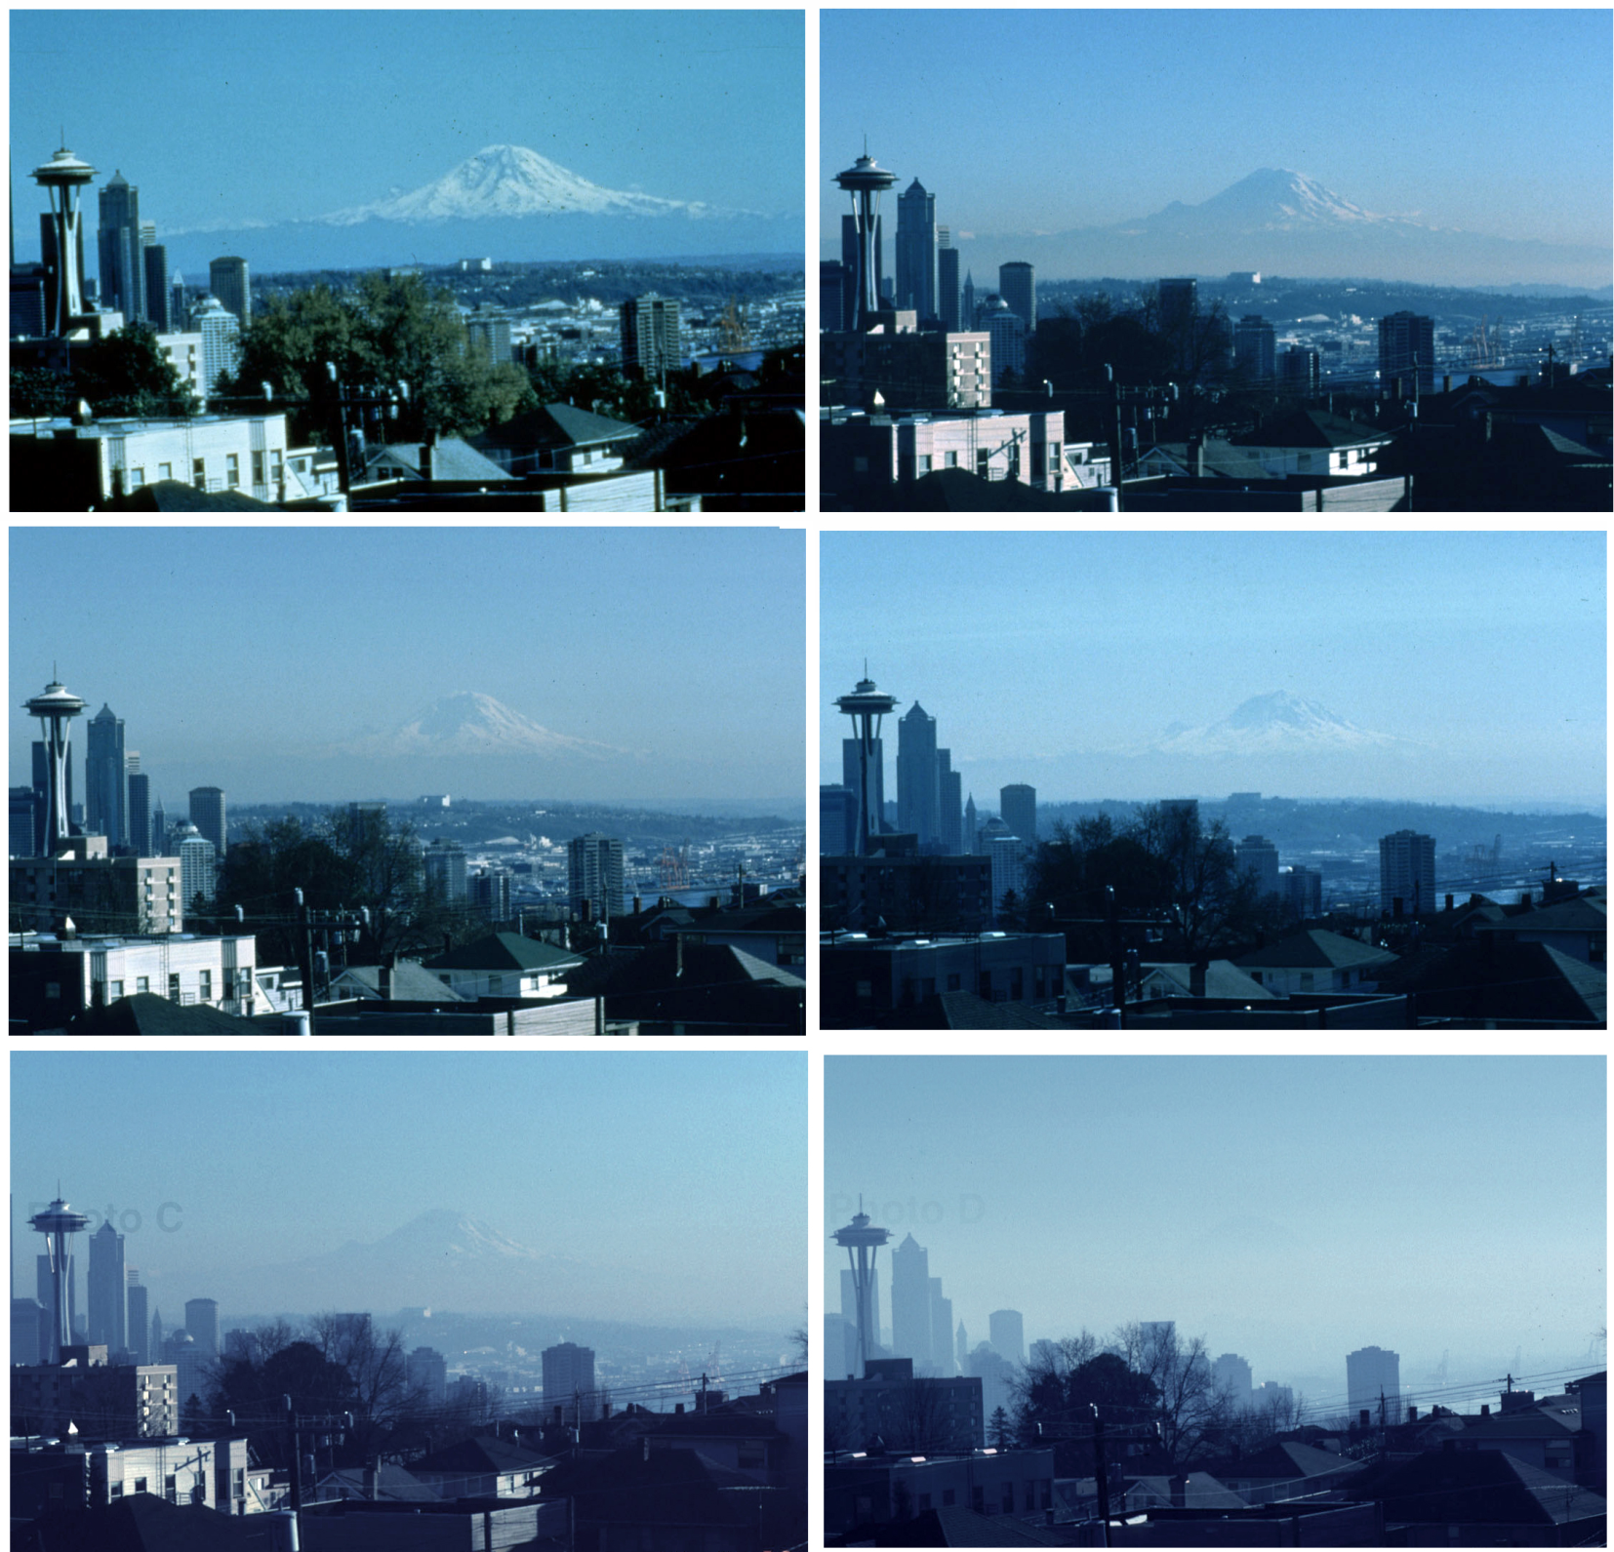
5 μg/m³
10 μg/m³
15 μg/m³
20 μg/m³
25 μg/m³
35 μg/m³

