Slide 1
Overview: The Aviation impacted communities act

Slide 2
Process established by aviation impacted communities act
FAA notifies communities of eligibility for “designated community” status
Designated community selects board members
Board Meetings
Study or Report
Action Plan
Grants for Mitigation Funds

Slide 3
How is an “aviation impacted community” defined?
Aviation Impacted Community: “A community located not greater than 1 mile from any point at which a commercial or cargo jet route is 3,000 feet or less above ground level.” (Sec. 7(2))

Slide 4
Community boards
What is the purpose of the community board?
“to provide information to airport operators and the FAA concerning disparate impacts and environmental justice related to the operation of commercial or cargo jet routes.”

Slide 5
Community boards
Who sits on community boards?
Local airport operators
Local elected leaders
Community representatives
OR, existing group primarily of local elected officials working on aviation-related issues
FAA representative will attend meetings

Slide 6
Community boards
What powers does the community board have?
Draft reports
Commission FAA-led studies
Instrumentation requests

Slide 7
Generate reports
Commission studies
Instrumentation requests
Community boards have the authority to request that the FAA provide additional noise instrumentation to measure airplane noise.
Community boards may collaborate with local airport operators and the FAA to draft a community report to detail community concerns and issues related to disparate impact.
Studies can include a range of different data points as agreed to by the community board. The studies will make recommendations to alleviate concerns of the community, and to address effects found in in the study.

Slide 8
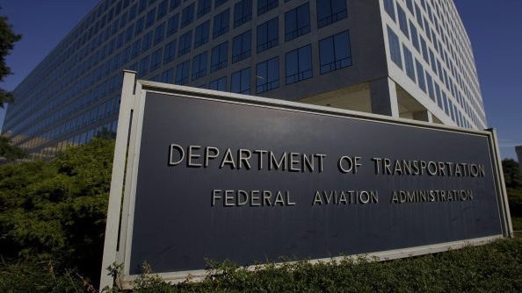
Roles/responsibilities of the faa
Designates an employee to work with each community board
Ensure a representative and/or expert from FAA attends each meeting of the community board
FAA representative may work with the board to draft the community report
FAA and each community board that petitions for a study shall collaborate together on the scope and methodology of such community study.

Slide 9
Action plans
Must be generated no later than 6 months after a community report
Must include a long-term regional plan that focuses on reducing/minimizing disparate impacts for the designated community
Must consider implementation of changes to operations and flight paths if the community report or community study indicates such changes would decrease the impacts on the designated community. If determined not to be effective, FAA must explain rationale.
Must be made publicly available

Slide 10
Mitigation funding
Based on Action Plan, FAA may make grants for (and set standards for) necessary noise mitigation in a designated community for certain structures (homes, hospitals, nursing homes, schools).
Mitigation options may include:
Sound insulation
Construction of noise barriers
Acoustic shielding to minimize ground-level noise
Funding for sound insulation may be provided in regions that experience “substantial increases in flight frequency” or from adoption of “new flight procedures” that create new noise impacts.
Authorizes FAA/ports to provide sound insulation in neighborhoods within a 55 DNL contour in which a significant number of flight operations are conducted between 10pm-6am.

Slide 11
Questions?

