Slide 1
Airport Financial Forecast & SAMP Impacts
Commission Briefing
May 8, 2018

Slide 2
Executive Summary
Baseline forecast of airport costs to airlines (CPE) is $20 in 2025, without Sustainable Airport Master Plan (SAMP) projects
Upper limit to Sea-Tac’s future CPE based on judgment, likely $25 - $30 for 2027 - 2030
Adding SAMP to baseline produces projected $36 CPE in 2027, likely not feasible
To make SAMP financially feasible (CPE <$30), must:
  Increase non-aeronautical net operating income (NOI)
  Manage growth of operating and maintenance costs
  Reduce projected capital spending
SAMP is financially feasible, but requires vigilant cost management and increased non-aero revenues

Slide 3
Financial Framework Established by Airline Lease Agreement (SLOA IV)
Aeronautical rates are set to recover costs
Aeronautical capital costs recovered depends on funding source:
  Cash funded – annual amortization based on life of asset
  Revenue bond funded – annual debt service
  Grants and PFC funded – no recovery, excluded from rate bases
Capital costs are added to rate base when asset is placed in service
Safety net: if airport debt service coverage is < 1.25x, airport may add “coverage” (non-cash cost) to airline rate bases as necessary to bring debt service coverage to 1.25x.
  Charging coverage in rate based magnifies the cost impact of a project
Non-aero investments must generate positive rate of return
Capital costs are primary CPE driver

Slide 4
Airport Capital Capacity
Capital costs are recovered through airline rates
Capital capacity of the airport is constrained by:
  Airport cost to airlines (CPE)
  Airport debt level, and ability to borrow
    Port’s credit rating
    Debt per enplaned passenger
Upper range to CPE is based on judgment of where “competitive” range will be in future
Airport capital capacity must consider multiple factors

Slide 5
Sea-Tac Financial Status
Airport CPE largely driven by capital program cycles
Period of moderate capital program has allowed Sea-Tac to maintain essentially flat CPE for many years ($10 – 13 CPE range since 2004)
Sea-Tac is financially well positioned today:
  Competitive CPE: 13th lowest out of 30 large hub airports in 2016
  Debt level as measured by debt per enplaned passenger compares favorably to peer airports (middle of range)
  Current credit rating for Port’s intermediate lien (primarily used by airport) is: A+ (S&P)/A1 (Moody’s)/AA- (Fitch)
  Strong liquidity: maintaining cash balance of at least 10 months of O&M costs ($250 million+)
Financing plan uses all available Passenger Facility Charge (PFC) revenues to pay for current capital plan, and ongoing PFC eligible revenue bond debt service
SEA is financially strong and well positioned to afford current capital plan

Slide 6
Cost Per Enplanement Trend
CPE declined through 2016 due to increased passenger levels, increased non-aero revenues and more airline revenue sharing
For 2017 – 2018, O&M costs growing faster than enplaned passengers
2018 increase vs. budget due to reduction in revenue sharing per SLOA IV
CPE trending up, but remains low compared to 2012 - 2013

Slide 7
Current CPE Comparison
CPE is competitive: SEA ranks 13 out of 30 Large Hub Airports

Slide 8
Comparative Debt Levels
Debt per enplaned passenger is a relative measure used to compare airports
Not all large hubs report debt levels
Noticeably absent are the three NY airports
Does not include SEA 2017 bond issue
Sea-Tac debt levels are at a reasonable level

Slide 9
Current Capital Program
Major projects under construction:
  North Satellite renovations and expansion (NSAT)
  International Arrivals Facility (IAF)
  Baggage Optimization
  Concourse D Hardstand Terminal
  Alternate Utility Facility
  Service Tunnel Renewal & Replacement
  Airfield Pavement Program and Taxiway Improvements
Anticipated major projects:
  Restroom Upgrades
  South Satellite renovation
  Main Terminal Low Voltage
  C-1 Building expansion
  Noise insulation: Highline School District & Condominiums
Allowance for future projects (capacity for new projects and/or cost increases)
Total of $4.1 billion for 2018 – 2027; with $3.0 billion for 2018 - 2022
Current capital program will drive up CPE

Slide 10
Baseline Forecast
Completion of major projects (NSAT, IAF and Baggage Optimization) will drive up CPE
Allowance provides capacity within forecast period for as yet undefined future projects
Debt service coverage remains above 1.25x
Current capital plan is affordable; however, does not include SAMP projects

Slide 11
Future CPE – Peer Airports
For SEA, forecast based on current capital program (pre-SAMP)

Slide 12
Limit to SEA CPE?
SEA is critical to the economic prosperity of the Puget Sound region
Excepting Paine Field, no realistic airport alternatives within 10-15 years
Many international gateway airports face high future investments to add capacity; much not yet incorporated into publicly available financial forecasts
  While no airport today shows forecasted CPE >$30, some likely will
  O’Hare recently announced $8.5 billion expansion to be added to program that already forecasts $25 CPE.
Port must strike balance between maintaining cost competitive airport for airlines and providing public with an airport that meets needs of region
At this point, staff estimates that $25 - $30 CPE is the upper limit to what could be deemed affordable for 2027 - 2030
With SAMP projects, SEA will target maintaining CPE among international gateway airports rather than middle third of 30 large hub airports
Sea-Tac well positioned to take on needed investments, but there are affordability limits

Slide 13
Projection: SAMP Scenario 1
Major SAMP project elements completed and in airline rate bases by 2027
Need to charge “coverage” in airline rate bases beginning in 2023 due to debt service coverage dropping below 1.25x exacerbates growth in CPE
Debt level more than triples. Impact on Port credit ratings uncertain, likely would see downgrade.
CPE of $36 likely too high – not financially feasible

Slide 14
SAMP Scenario 2
To achieve CPE<$30:
  Extend bond amortization from 25 – 30 years
  Targeted growth in Non-aero revenues and NOI:
    Non-aero revenue per enplanement in 2018: $9.93
    Baseline forecast for 2027: $10.50
    Targeted projection for 2027: $11.92
    Assume revenues drop down as NOI: +$40 million in 2027
  Reduced capital spending by $845 million:
    Reduce budget for South Satellite renovation by $400 million (effectively deferring reconstruction), but still allowing for significant improvements ($200 million)
    Reduce Allowance CIPs by $445 million (reduces flexibility for ongoing needs)
    IAF project may consume much of remaining Allowance, reducing flexibility further
With these modified assumptions, SAMP appears to be financially feasible

Slide 15
Projection: SAMP Scenario 2
Debt service coverage drops below 1.25x in 2027, requiring charging $64 million of coverage in rate base.
CPE and Debt Per Enplanement levels high, but financially feasible

Slide 16
SAMP Scenario 3
Vehicular access to airport will likely evolve in next ten years
  Transportation Network Companies (TNCs) may continue to erode demand for rental cars
  Move towards autonomous vehicles will likely impact demand for airport parking
SAMP Scenario 3 shows impact on CPE of 10% decline in rental car and public parking revenues by 2027
Impact:
  Increases amount of coverage added to airline rate based to achieve 1.25x debt service coverage, thus driving up CPE to $32.32
  Or, achieving CPE of $29.99 would require reduced capital spending of $637 million
Decline in Non-aero NOI results in increased CPE or reduced capital capacity

Slide 17
Projection: SAMP Scenario 3
Reduced Non-aero NOI drives up 2027 CPE to $32.32
Achieving 2027 CPE of $29.99 would require reduced capital spending of $637 million.
Reduced Non-aero NOI will negatively impact SAMP financial feasibility

Slide 18
SAMP Scenario 2 vs. Baseline
Requires deferring reconstruction of SSAT
Limited Allowance for new CIPs or additional spending is a risk
  Need to find scope and/or cost savings in baseline and SAMP
CPE at high end of feasible range, should be reduced
Need to develop strategies to reduce coverage charged by:
  Increasing Non-Aero NOI
  Reducing O&M costs
Debt level will double
SAMP 2 projection is financially feasible, but requires business strategies and decisions

Slide 19
SAMP: Risks and Opportunities
Risks:
  Plan assumes growth in non-aero NOI can be realized
  Projects could cost more than current estimates
  Unforeseen project needs (e.g., renewal and replacement) could consume some capital capacity
Opportunities:
  Time to align business strategies to grow non-aero NOI and reduce future spending
  Scope, budget and project timing for SAMP projects still very preliminary
To reduce future CPE and debt levels, staff will explore strategies to:
  Manage growth of O&M costs (Airport and Central Services)
  Increase Non-aero NOI
  Partner with airlines, use airline consortium where appropriate
  Prioritize future capital improvements, reduce or eliminate scope
  Pursue additional FAA grants
  Seek to reduce financing costs through additional structuring alternatives
  Incorporate public, private partnerships where strategically prudent
Port will strive to meet the region’s air transportation needs in a cost effective manner

Slide 20
Summary
Constructing the SAMP projects will significantly increase CPE and debt for Sea-Tac.
While a $25 - 30 CPE would appear to be “too high” for Sea-Tac today, by 2027 other international gateway hubs will likely be in this range, or higher.
Maintaining CPE <$30 appears necessary for financial feasibility
Port must vigilantly pursue strategies to manage growth of CPE
Cost to region of not expanding Sea-Tac is also high: increased congestion, fewer direct flights, lost economic opportunities.
SAMP is financially feasible, but requires vigilant cost management and increased non-aero revenues

Slide 21
Appendix
Additional Background Materials

Slide 22
Financial Goals
Cash flow: Adequate annual debt service coverage (>1.25x)
Liquidity: Cash reserves equal to 10 months of O&M costs
Leverage: Reasonable debt levels (debt per enplaned passenger)
Cost structure: competitive passenger airline cost per enplaned passenger (CPE), competitive airline rates
Capital capacity to:
  Maintain and upgrade existing assets
  Add capacity to meet region’s air transportation needs in cost effective manner
Achieving financial goals necessary to achieve Century Agenda goals

Slide 23
CPE Drivers
CPE = passenger airline costs (capital and O&M) divided by enplaned passengers
Changes in passenger level directly impact CPE calculation
O&M costs – adds to baseline costs
Capital costs – debt service or amortization of new capital projects
Rate base charges for debt service coverage if needed to achieve 1.25x annual debt service coverage

Slide 24
Enplaned Passengers 2012 - 2027
Recent growth much faster than expected
2018 assumes 5% growth
2019 – 2024 growth tied to SAMP 2024 Forecast
2025 – 2027 based on SAMP
20% growth 2017 - 2027
41% growth 2012 - 2017
Enplaned passenger forecast is based on SAMP

Slide 25
Non-Aero Revenue Per Enplanement Trend
2017 included one-time lump sum payment from DMCBP Phase II in-lieu fees.
2018 ADR revenues impacted by construction in Central Terminal
Budgeting for decline in rental car revenues
Non-Aero Revenue per enplanement growth maintained

Slide 26
Non-Aero Revenue vs. Peer Airports
All airports are different
For example, more international passengers generate more duty free revenues
Staff is analyzing data to identify opportunities
Benchmark data suggests Sea-Tac can improve

Slide 27
Targeted Non-Aero Revenue Growth
Baseline forecast shows modest revenue growth
ADR lease transitions limit growth in early years
Targeted growth begins in 2021, picks up in 2024. Used for SAMP 2 Scenario.
Targeting revenue per enplanement of $11.92 by 2027

Slide 28
O&M Costs
Compared to peer airports, as of 2016 SEA compared favorably
Internally, since 2015, O&M costs have been growing faster than enplaned passengers with O&M per enplanement increasing from $11.28 (2015) to $13.45 (2018), or 19%
New facilities such as IAF, Concourse D Hardstand Terminal, and IAF will add to O&M
As projected enplanement growth levels off after 2018, O&M per enplanement will continue to grow.
O&M effectively consumes capital capacity by growing baseline CPE and/or reducing non-aeronautical NOI.
Managing O&M cost growth needs to be a priority

Slide 29
O&M Per Enplanement - Trend
Increase driven by:
  Employee screening function and 103 FTEs
  Custodial contract
  Maintenance
  Operations
  Planning
  SAMP Environmental
  Police resources
O&M growing faster than passengers in 2018

Slide 30
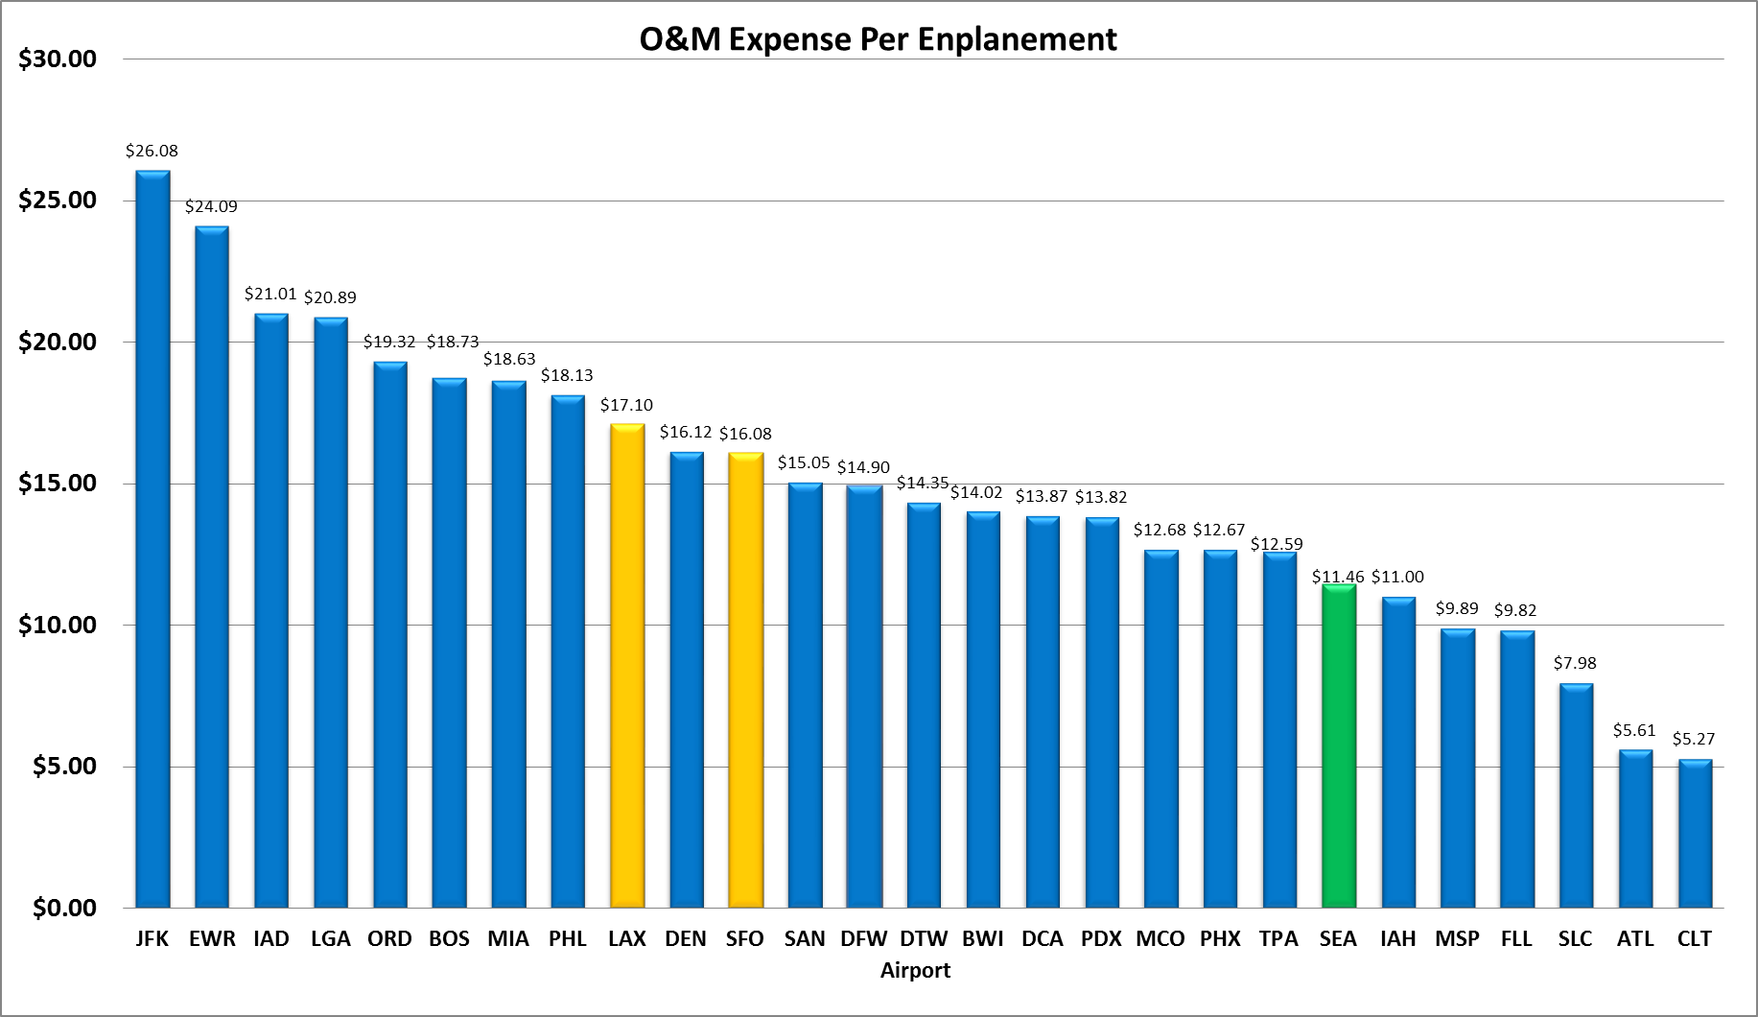
O&M Per Enplanement vs. Peer Airports - 2016
Most recent O&M per enplanement compares favorably to peer airports

Slide 31
Forecast of O&M Per Enplanement
Timing and O&M costs of new assets related to SAMP needs additional analysis
Costs associated with generating new non-aero revenues also needs further analysis
O&M costs forecasted to grow much faster than enplaned passengers

Slide 32
Public, Private Partnerships (P3)
Many airport have turned to P3 as a strategy to do some combination of: design, build, operate, maintain, and finance projects.
LAX recently agreed to $4.9 billion 30-year contract for People Mover. Construction cost is $2.0 billion of total contract.
Port will investigate how/if P3 can be helpful to implementation of SAMP

