Slide 1
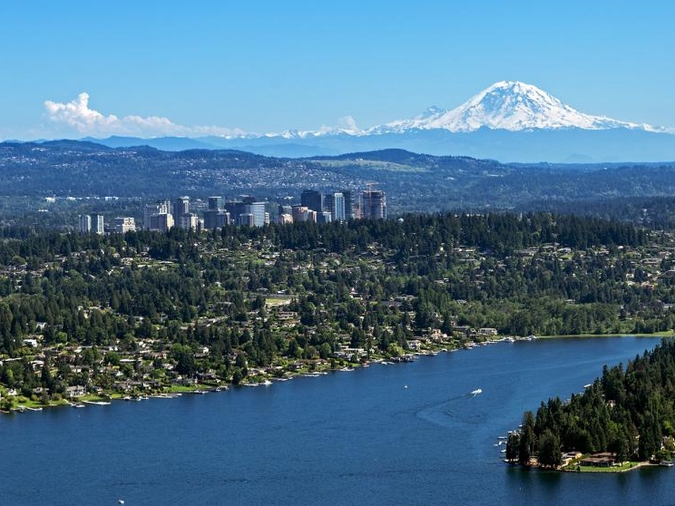
Characterizing Ultrafine Particulate Matter and Black Carbon Exposure Levels for a Seattle-Based Cohort From a Mobile Monitoring Campaign
Magali Blanco, PhD
Env. and Occ. Health Sciences, School of Public Health
magali@uw.edu
Amanda Gassett, Timothy Gould, Annie Doubleday, David L. Slager, Elena Austin, Edmund Seto, Timothy Larson, Julian D. Marshall, Lianne Sheppard
Funding: ACT – Air Pollution Study (National Institute of Environmental
Health Sciences; National Institute on Aging, R01ES026187)
Notes:
-Work was conducted as part of my dissertation
-funded: NIEHS; NIA
-I’ll cover some background before describing the work we conducted

Slide 2
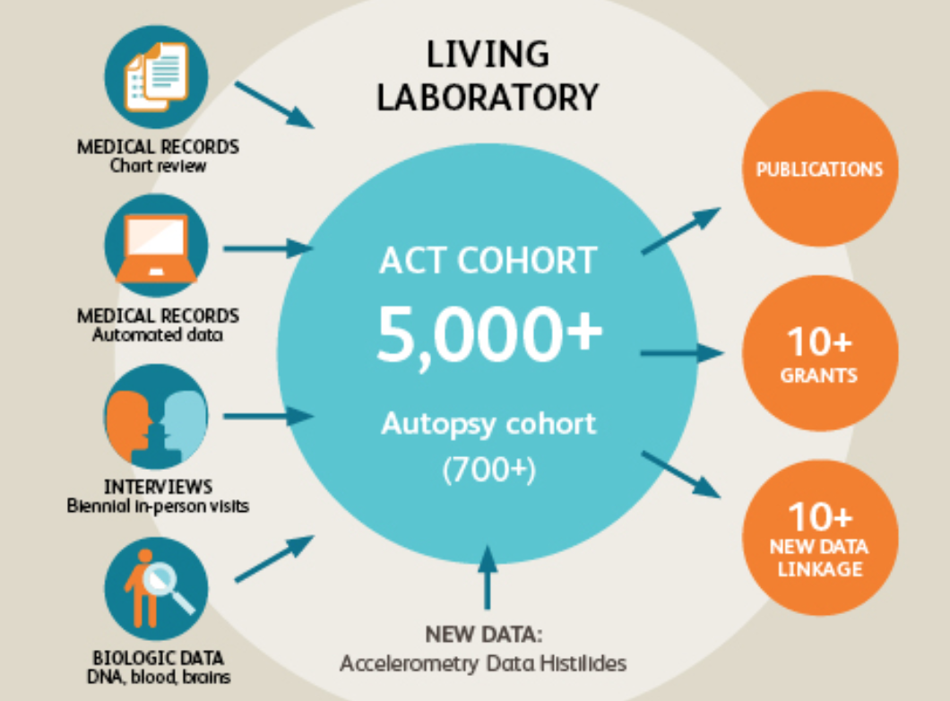
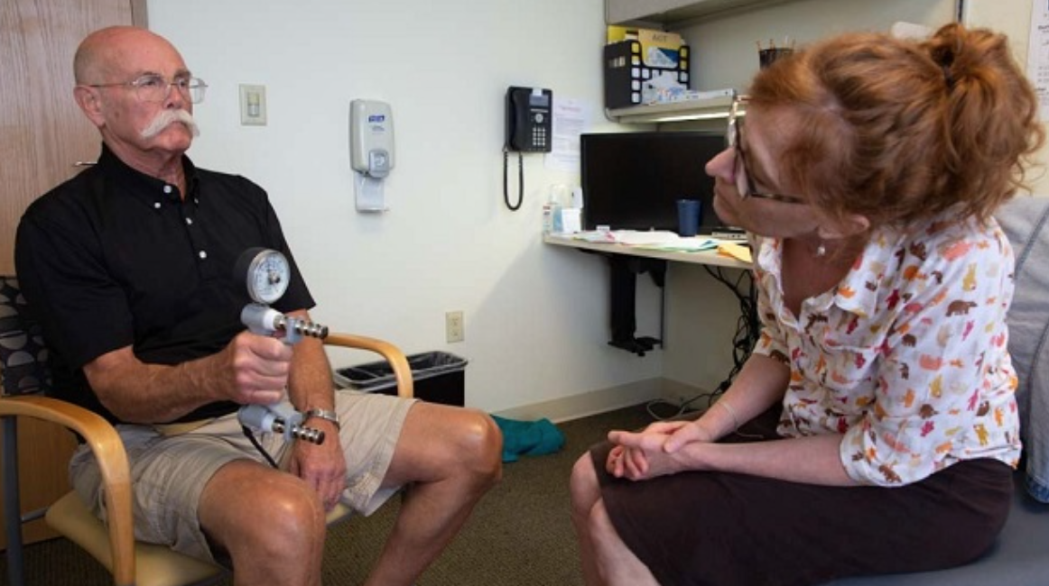
Adult Changes in Thought (ACT) Study
Seattle-based prospective cohort study investigating aging and the brain
Started in 1994
Participants
Elderly individuals (65+ yr)
Dementia-free at baseline
Participants are followed until they are diagnosed with dementia
Top: Huges 2018. Bottom: Bowles 2019. ACT study visit – grip strength test.
Notes:
An ideal cohort to study long-term air pollution exposure & dementia incidence

Slide 3
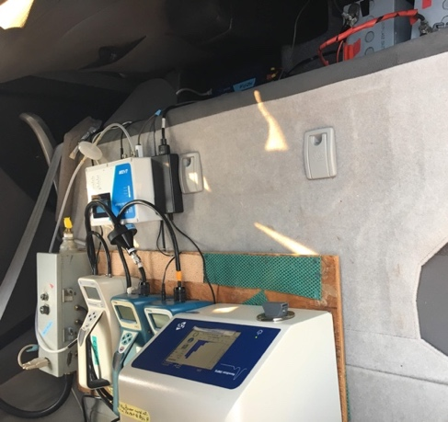
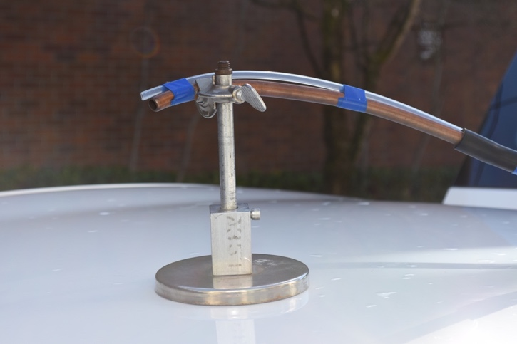
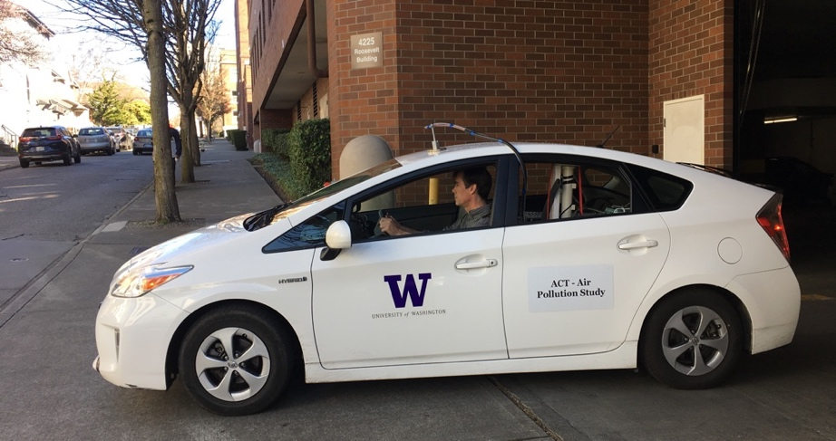
Mobile Monitoring
Collect repeated short-term samples used to estimate long-term averages
Time- and cost- efficient
Site sampling duration can be very short
Increased spatial coverage
One platform
Convenience sampling
Short time periods (e.g., Mon-Fri)
Non-residential areas (e.g., highways, industry)
Mobile, on-road samples (vs. stationary samples near residences)
Top to bottom: 1) Instrumentation in the mobile monitoring vehicle. 2) Sampling inlet on vehicle rooftop. Photograph by Sarah Fish, fischs@uw.edu. 3) Mobile monitoring vehicle.
Notes:
* We were interested in using mobile monitoring to assess air pollution exposure
# References
• Mobile monitoring campaigns to characterize average air pollution levels (Apte et al. 2017; Hatzopoulou et al. 2017; Kerckhoffs et al. 2016; Messier et al. 2018; Xie et al. 2017)

Slide 4
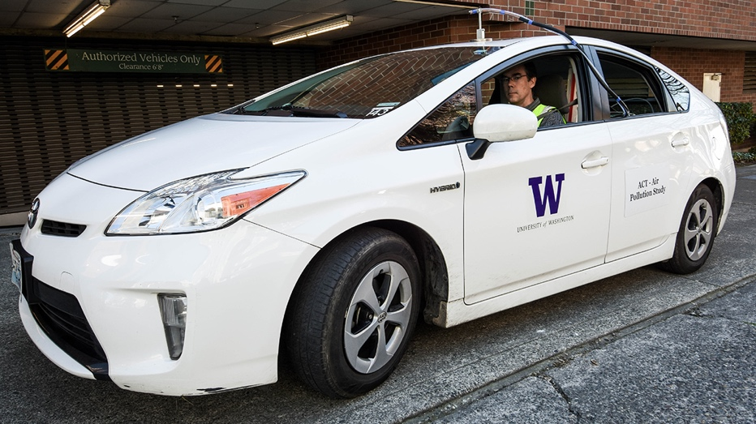
Study Overview
Conducted a mobile monitoring campaign to measure annual-average traffic-related air pollution levels for the ACT cohort
Built UFP and BC prediction models
Characterized exposure for the ACT cohort and the greater Seattle area
Photograph by Sarah Fish, fischs@uw.edu.

Slide 5
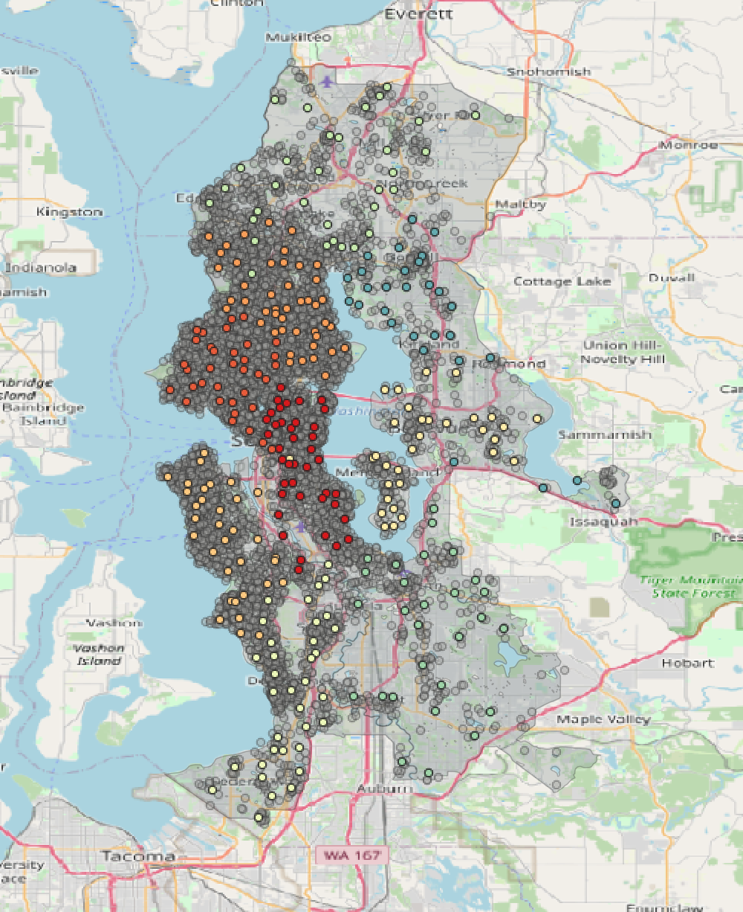
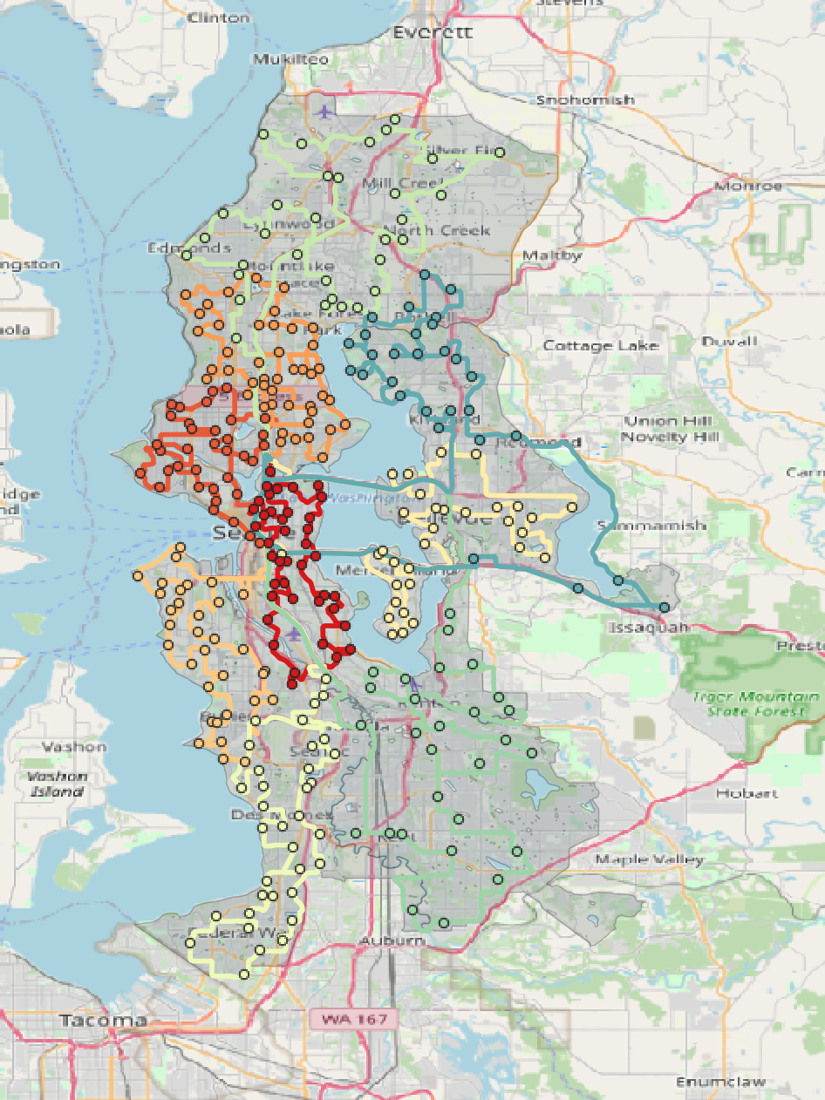
Our Mobile Monitoring Campaign
Purpose: Address past monitoring limitations
309 stop locations representative of ACT cohort (large, geographically diverse area)
9 fixed driving routes
2-min samples per stop
Measured UFPs, BC, PM_{2.5}, CO, CO₂, NO₂
A driving schedule ensured temporally balanced sampling
Top: Jittered ACT locations and monitoring stops. Bottom: Mobile monitoring routes and stops

Slide 6
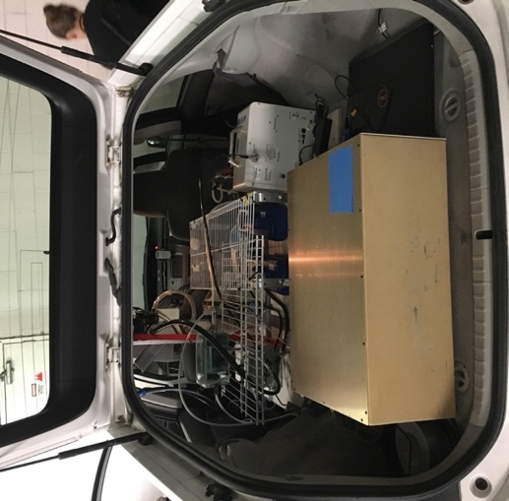
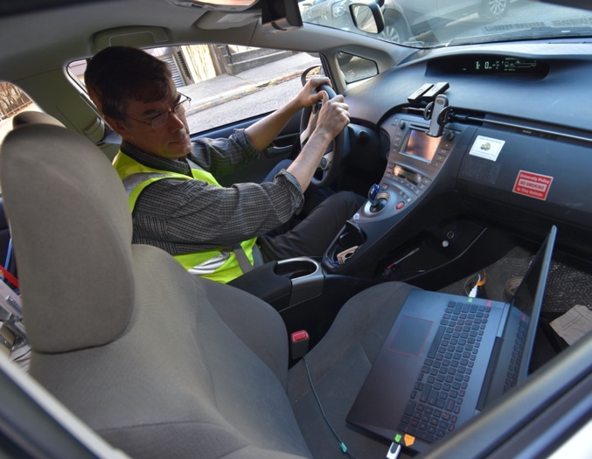
Final Samples
Collected ~27 samples per site
5 AM – 12 AM
March 2019 – March 2020
>270 drive days
Left: Instruments inside the vehicle. Right: Monitoring laptop. Photograph by Sarah Fish, fischs@uw.edu.
Notes:
This was a fairly extensive campaign

Slide 7
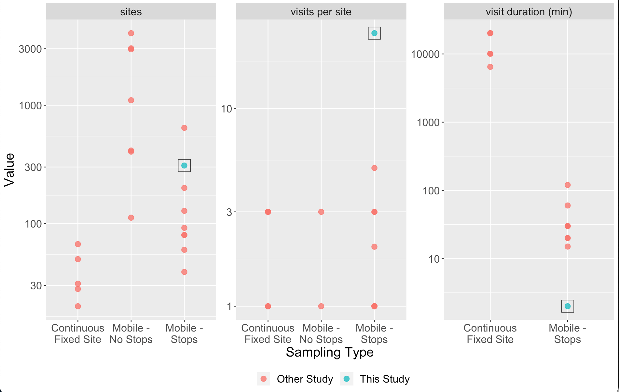
Sampling Approaches Across Other UFP Studies
Compared to other similar studies, we had:
More sites
more repeat visits
Shorter visits
Similar for BC
Notes:
To put this into perspective, we can compare some of the features of our study design to other studies. On the x-axis you have studies stratified by the type of sampling type that was conducted…3 types…Our study is in teal. We can see that overall, we generally sampled more study sites, visited each site more times even though we were there for shorter periods of time

Slide 8
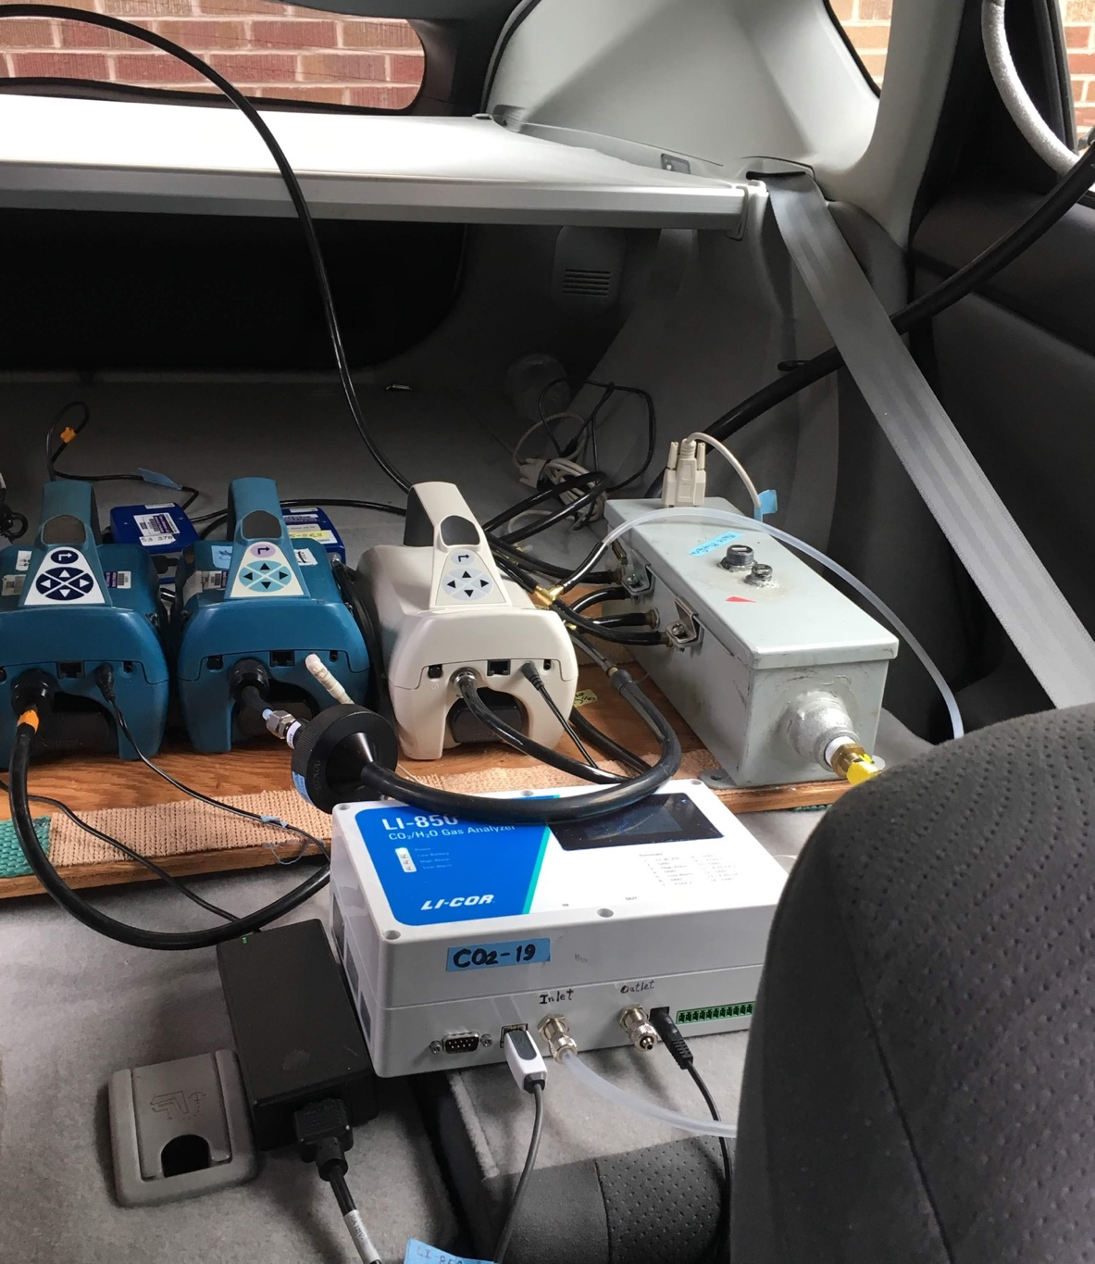
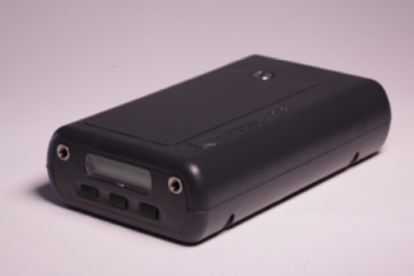
Instrumentation
UFPs: P-TRAK 8525 (TSI)
Time resolution: 1 sec
Particle size range: 20-1,000 nm diameter
BC: MicroAeth, MA200 (AethLabs)
Time resolution: 10 sec
Wavelength: 880 nm (IR)
Top: P-TRAKs in the monitoring vehicle.
Bottom: MicroAethalometers (AethLabs, 2018).

Slide 9
Annual Averages
Calculated site annual averages using linear regression to address unbalances in data
Annual average UFP estimates from mobile monitoring observations.
Notes:
The first step of this analysis involves data reduction.
Median site visit concentrations
Trimmed extreme observations at each site

Slide 10
Prediction Models
Built universal kriging (UK) models using partial least squares (PLS) and geostatistical smoothing (kriging):
$$log⁡(Conc)=α+\sum_{m=1}^{M}{θ_{m,s}Z_{m,s}}+ ε$$
where $Z_{m,s}$ are the PLS component scores; $α$ and $θ_{m,s}$ are estimated model coefficients; $ε$ is the residual term with mean zero and a geostatistical structure modeled as an exponential function with range 𝜙_{𝑖}, partial sill 𝜎_{𝑖}, and nugget 𝜏_{𝑖}
Notes:
PLS summarized hundreds of geographic covariates into a smaller number of new features
Kriging allows for spatial correlation in the data…Models part of the structure that resides in error term not otherwise captured by regression

Slide 11
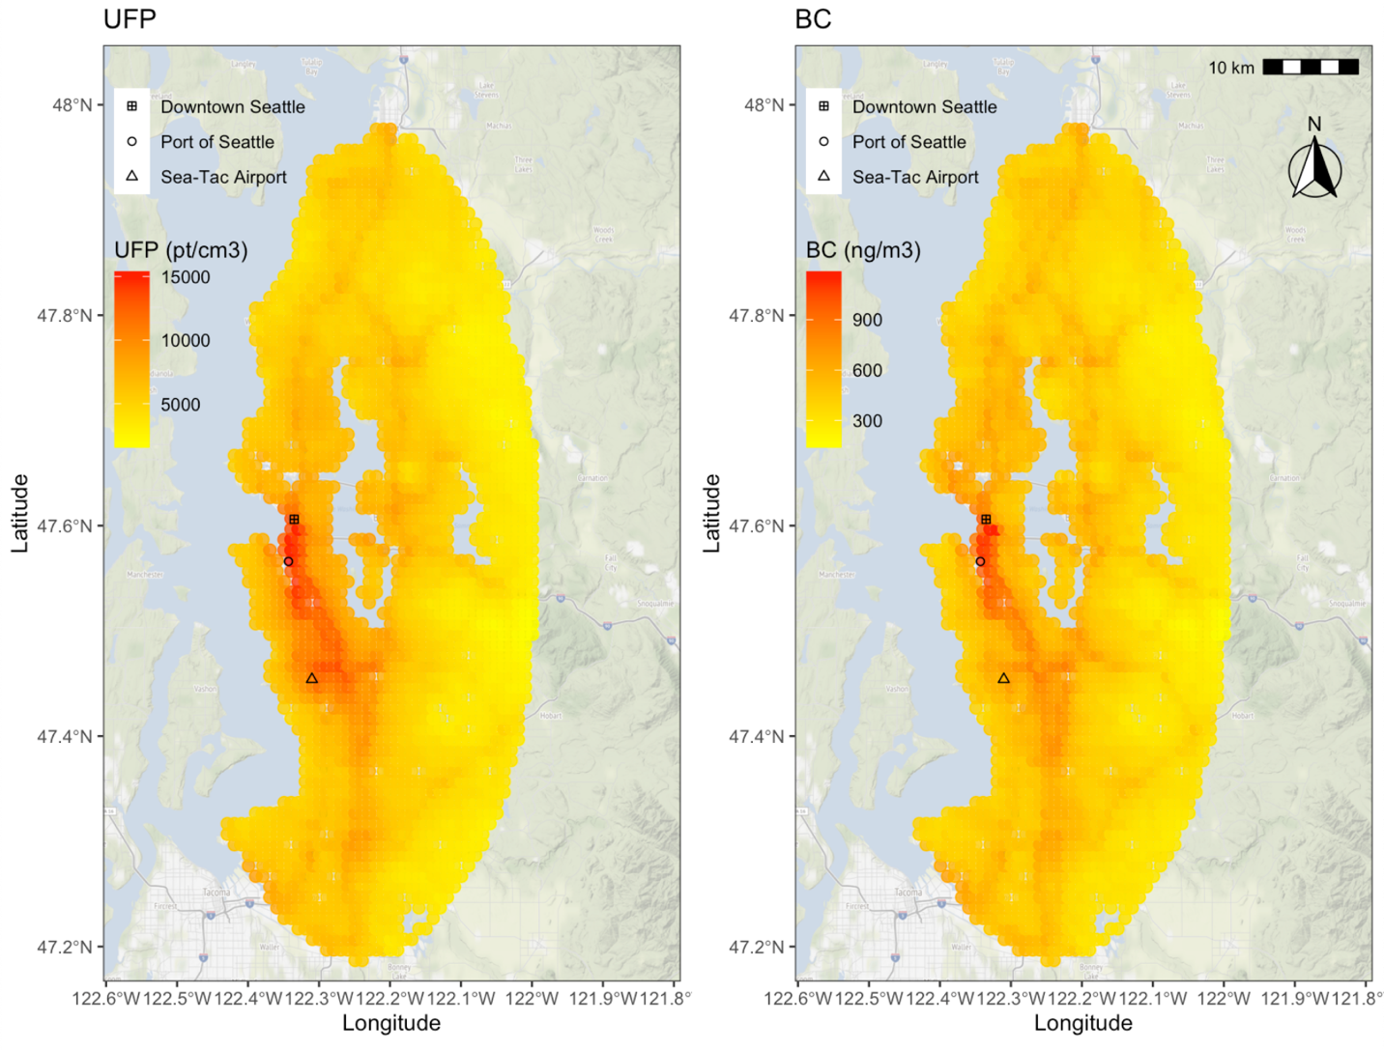
Predicted UFP and BC Exposure Surfaces
Higher predicted concentrations between downtown and the airport, on highways

Slide 12
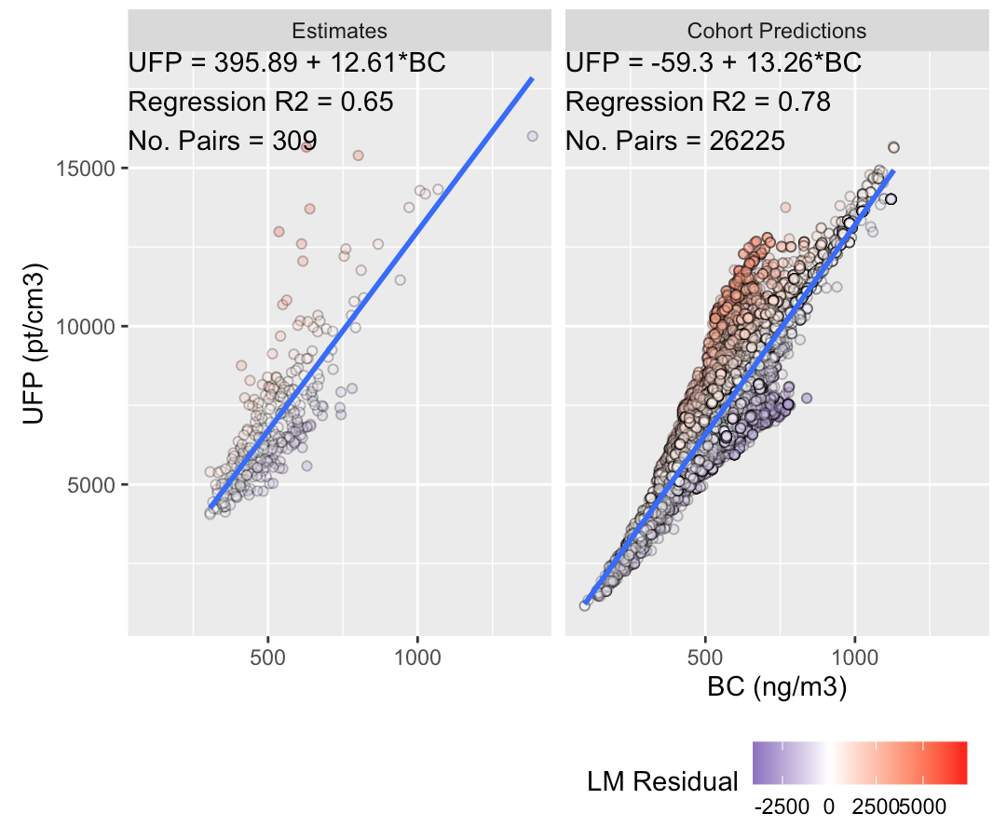
Differences in UFP and BC Surfaces
Can BC be used as a surrogate for UFP?
UFP levels at some locations are mischaracterized more when using BC models (large residuals)

Slide 13
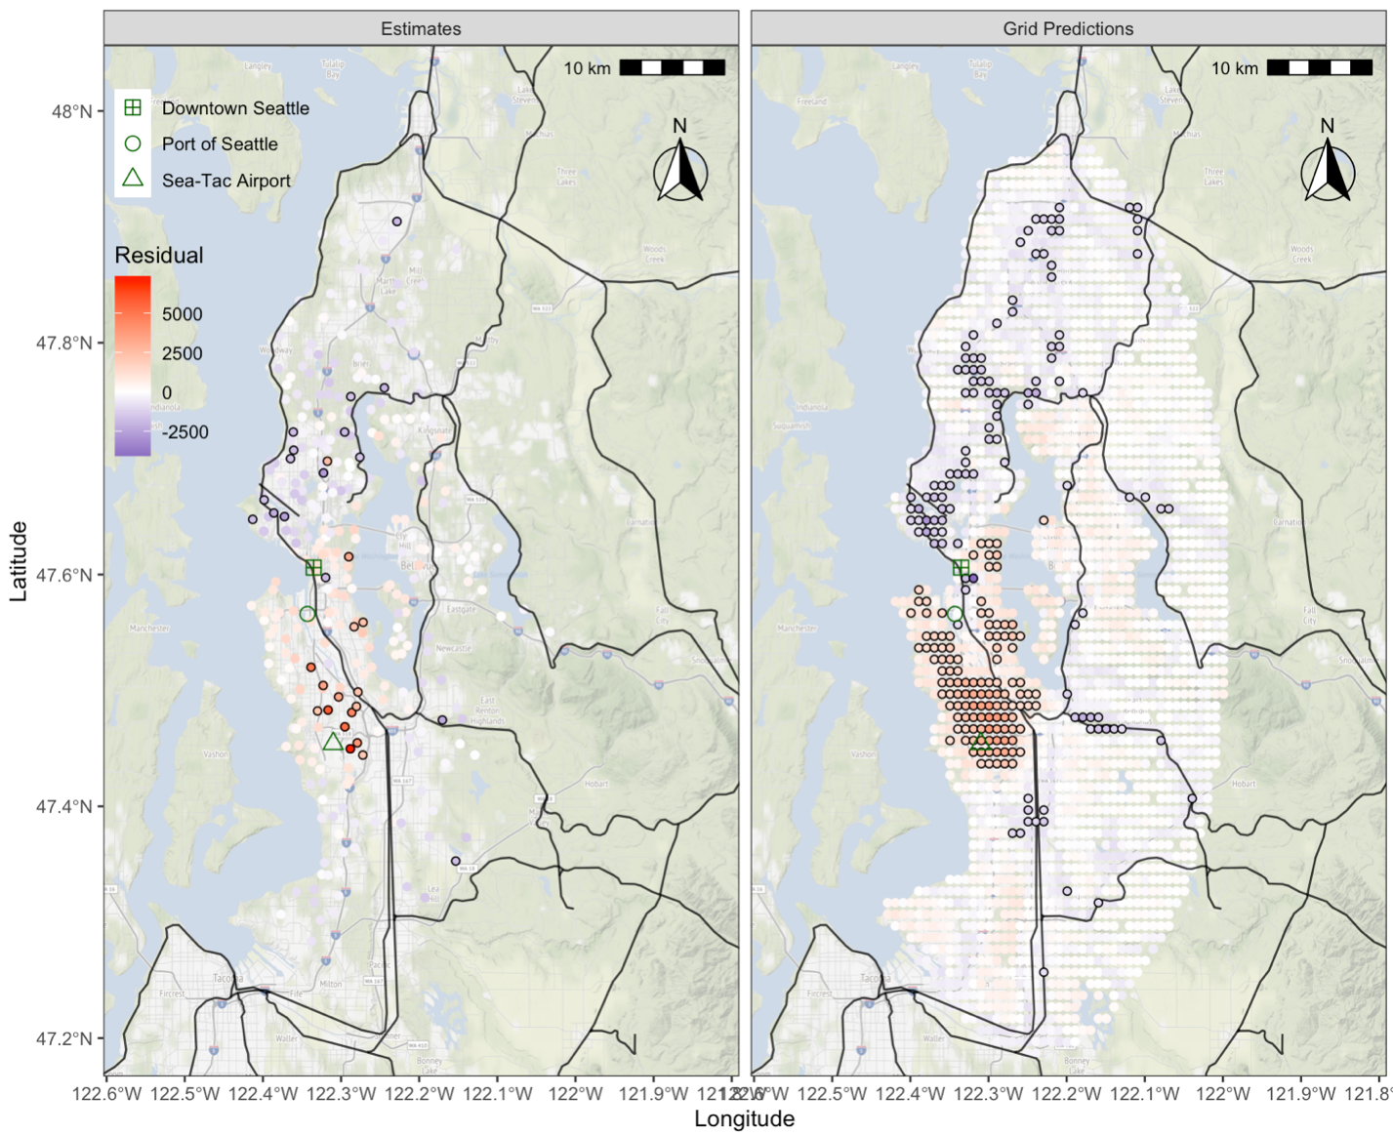
Differences in UFP and BC Surfaces
Plotting the difference between UFP observations and predictions based on BC models (residuals)
UFP levels were:
(+): Sea-Tac Airport
(-): Rail yards, large ports
UFP residuals for UFP-BC linear regressions using estimates (from mobile monitoring observations) and model predictions (at grid locations). Black circles are locations with high residuals (< 5th quantile or > 95th quantile); black lines are railroads. Residual predictors were selected using Lasso regression.

Slide 14
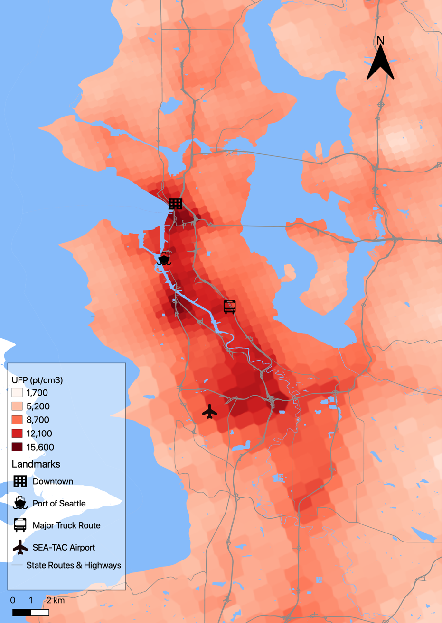
Conclusions
First to characterize the long-term UFP and BC exposure surface with high spatial resolution for the greater Seattle area
Innovative mobile monitoring campaign specifically designed for epidemiologic application
Differentiated UFP and BC surfaces
Next steps: use of these models in epidemiologic studies
Top: UFP predictions from the Seattle area. Bottom: Our mobile monitoring vehicle. Photograph by Sarah Fish, fischs@uw.edu.
Notes:
* Our study may be the largest in terms of:
Spatial extent covered
Sampling density
Sampling frequency & duration

Slide 15
Acknowledgements
PhD Committee
Lianne Sheppard
Edmund Seto
Tim Larson
Sara Adar
Julian Marshall
Mobile monitoring team
Amanda Gassett
Jim Sullivan
Dave Hardie
Tim Gould
Additional Support
Brian High
Elena Austin
ACT-AP team
Gail Li
Paola Filigrana
Funding
ACT – Air Pollution Study (NIEHS, NIA, R01ES026187)
BEBTEH: Biostatistics, Epidemiologic & Bioinformatic Training in Environmental Health (NIEHS, T32ES015459)
ARCS Foundation Fellowship
Contact:
Magali Blanco, PhD
Environmental and Occupational Health Sciences, School of Public Health
magali@uw.edu

Slide 16
Image Credits
AethLabs. 2018. microAeth MA200 Tech Specs. https://aethlabs.com/sites/all/content/microaeth/ma200/microAeth%20MA200%20Specifications %20Sheet%20Rev%2001%20Updated%20Aug%202018.pdf
Bowles. 2019. The ACT study: Looking toward the future. Kaiser Permanente. https://www.kpwashingtonresearch.org/news-and-events/blog/2019/august-2019/act-study-looking-toward-future
Hughes. 2018. ACT study: Long-running study of aging examines changes in Kaiser Permanente patients over time. Kaiser Permanente. https://www.kpwashingtonresearch.org/our-research/research-areas/aging-geriatrics/act-study-long-running-study-aging-examines-changes-kaiser-permanente-patients-over-time
King County Metro. 2020. Where will people live in 2040? http://www.kcmetrovision.org/king-county-in-2040/where-will-people-live/

Slide 17
Appendix

Slide 18
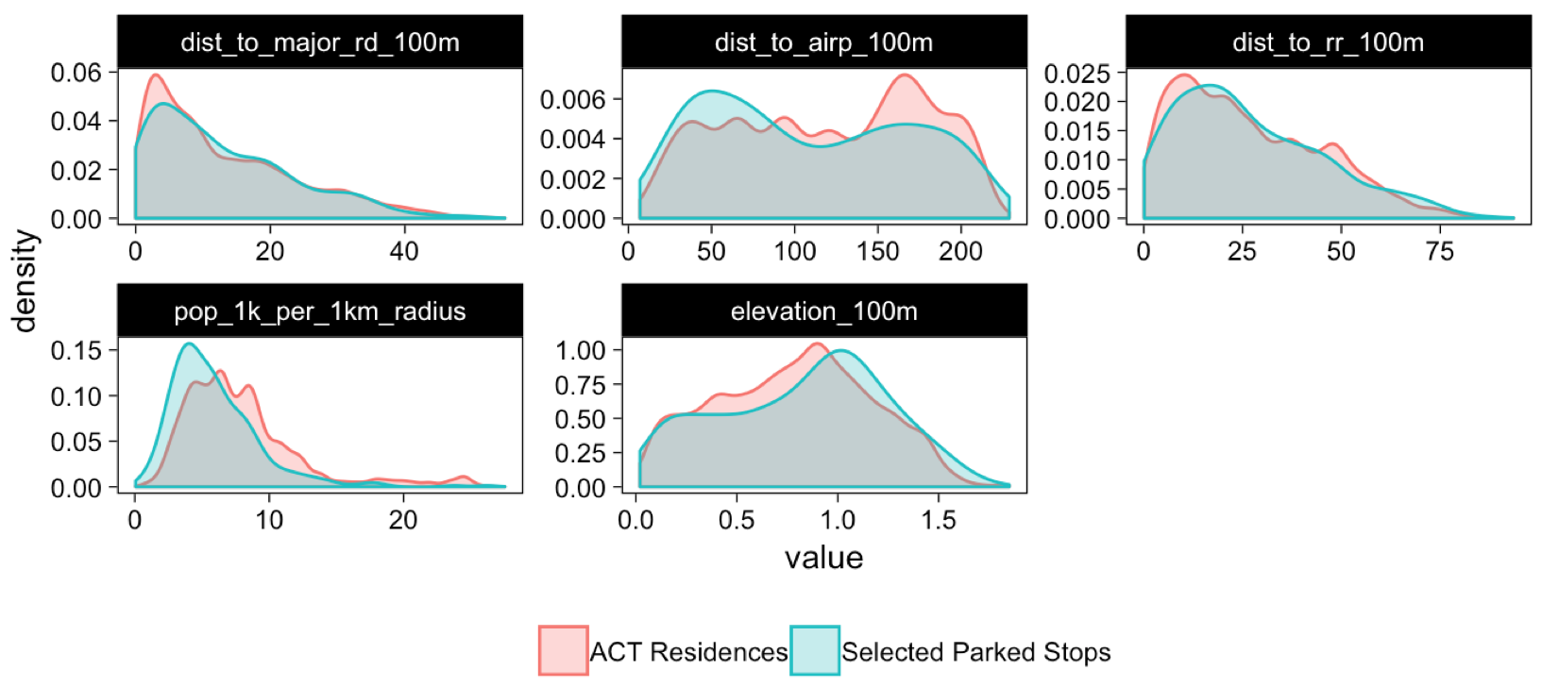
Monitoring Stops & ACT Locations
Stop locations and ACT residences had similar geocovariate distributions (spatial compatibility)
Left: density plots of geocovariate distributions for monitoring stops and ACT locations. Right: Map of jittered ACT locations and monitoring stops.

Slide 19
Instrument Specifications
Parameter | Instrument | Manufacturer | Measurement Range | Limit of Quantification | Time Resolution
Particles
UFP
10-420 nm (and 13-bin PSD) | NanoScan 3910 | TSI | 10²-10⁶ pt/cm³ | 10 pt/ cm³ | 60 sec
10-700 nm | DiSCmini | Testo | 10³-10⁶ pt/cm³ | 500-2,000 pt/cm^{3 b} | 1 sec
20-1,000 nm | PTRAK 8525 | TSI | 0 - 5 x 10⁵ pt/cm³ | 1 pt/cm³ | 1 sec
50-1,000 nm | PTRAK 8525, with diffusion screen | TSI | 0 - 5 x 10⁵ pt/cm³ | 1 pt/cm³ | 1 sec
BC & UV PM (5 wavelength abs analysis) | microAeth MA200 | AethLabs | 0-1 mg BC/m³ | 30 ng BC/m^{3 c} | 10 sec
Light scattering extinction coef (PM_{2.5}) | M903 | Radiance Research | 0 - >1 km⁻¹ | 10⁻⁶ m⁻¹ | 10 sec
Gases
NO₂ | CAPS NO₂ | Aerodyne Research, Inc. | 0-2,000 ppb | 2 ppbv | 1 sec
CO₂ | SenseAir CO2 K-30-FS sensor | CO2Meter.com | 0-5,000 ppm (vol) | 100 ppmv | 1 sec
CO | CO Monitor T15N | Langan, Inc. | 0-200 ppm | 0.1 ppm | 1 sec
Other
Temperature | Onset UX100-011 | HOBO | -4-158°F |  | 1 sec
Relative humidity | Onset UX100-011 | HOBO | 0-95% |  | 1 sec
Positioning & real-time tracking | DG-500 | US GlobalSat | 0-515 m/sec speed | 2.5 m | 1 sec

Slide 20
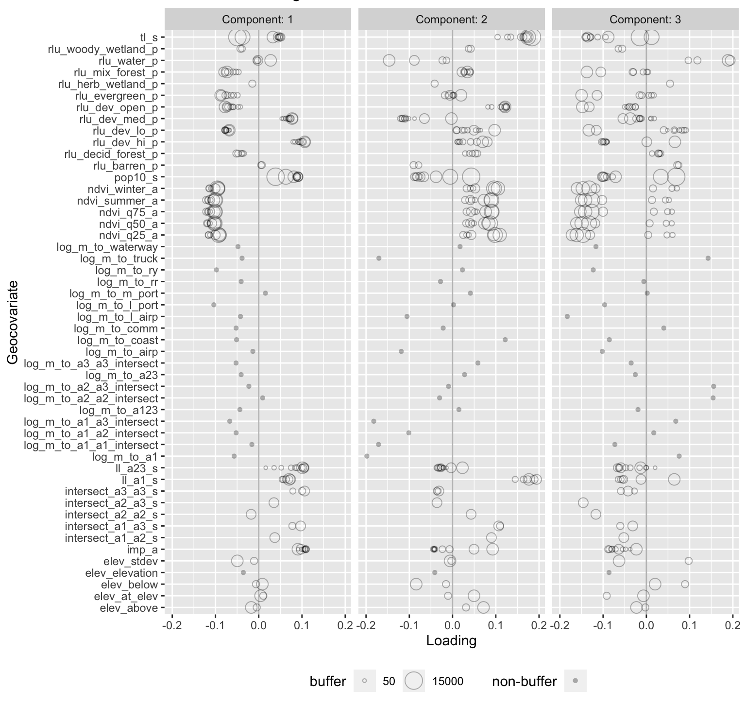
Strong UFP and BC Predictors
Length of major roads
Population density
Land development, imperviousness
NDVI, green space
Distance to large port, rail yard
In line with literature
PLS component loadings for UFP model

Slide 21
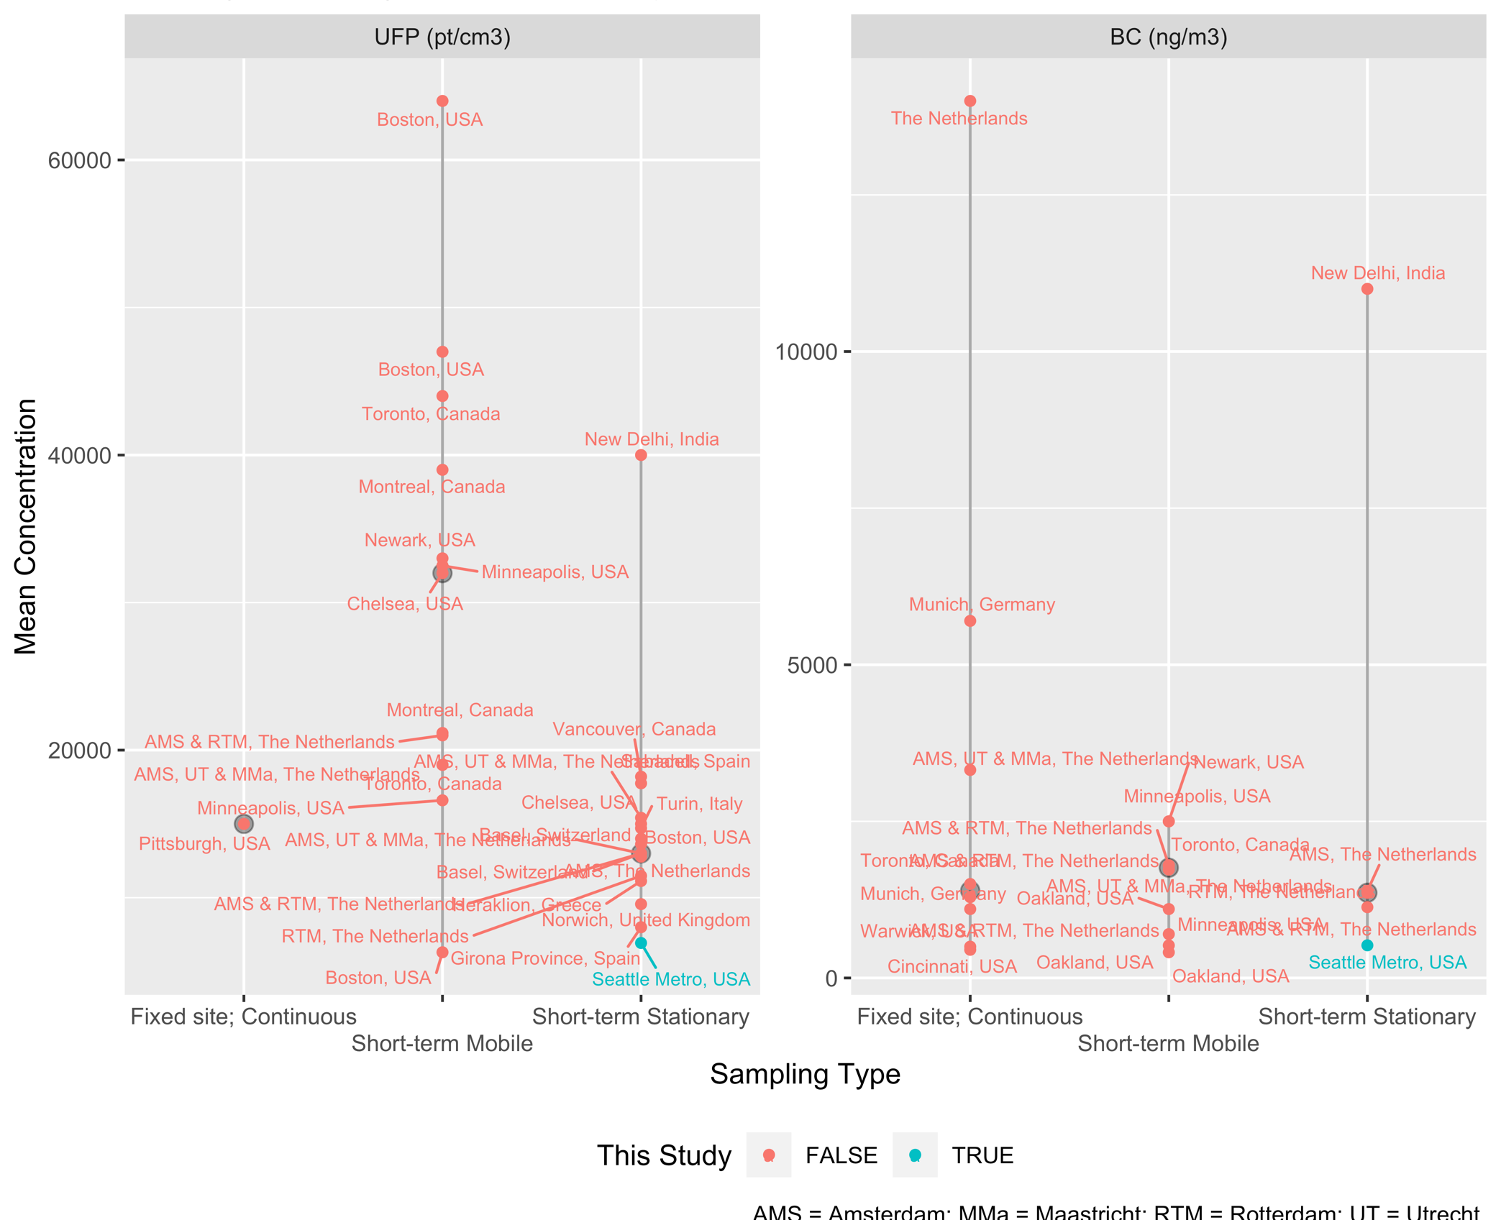
Exposure Predictions for the ACT Cohort
Pollutant | Median | Range
UFP (pt/cm³) | 6,782 | 2,491-15,682
BC (ng/m³) | 525 | 232-1,130
A large degree of exposure variation
Low levels
Seattle’s air
Similar to rural/suburban locations
Wider geographic area & sampling times
Estimated mean/median UFP and BC concentrations from other studies. Gray dots and vertical lines are the median and range.
Notes:
Though it is difficult to compare UFP lvls across studies b/c studies use different size ranges, based on instrumentation
Though our analyses did not show any clear reason for large coc discrepancies between studies when we compared instruments used and the concentrations reported by those studies
EPA has noted this as a limitation in the field
REFS
*BC levels:
Sources: Oakland, CA: Apte et al. 2017; The Netherlands: Kerckhoffs et al. 2016 & 2017, Montagne et al. 2015; Toronto, CA: Minet et al. 2018; New Delhi, India: Saraswat et al. 2013

Slide 22
Limitations
Mobile monitoring stop averages may be noisy (27 two-min samples/site)
≤20% error
Regression approach for estimating annual averages assumes that sites have similar temporal trends
Limited built environment covariates that may impact dispersion (e.g., street width)
But does include correlated covariates (e.g., population)

Slide 23
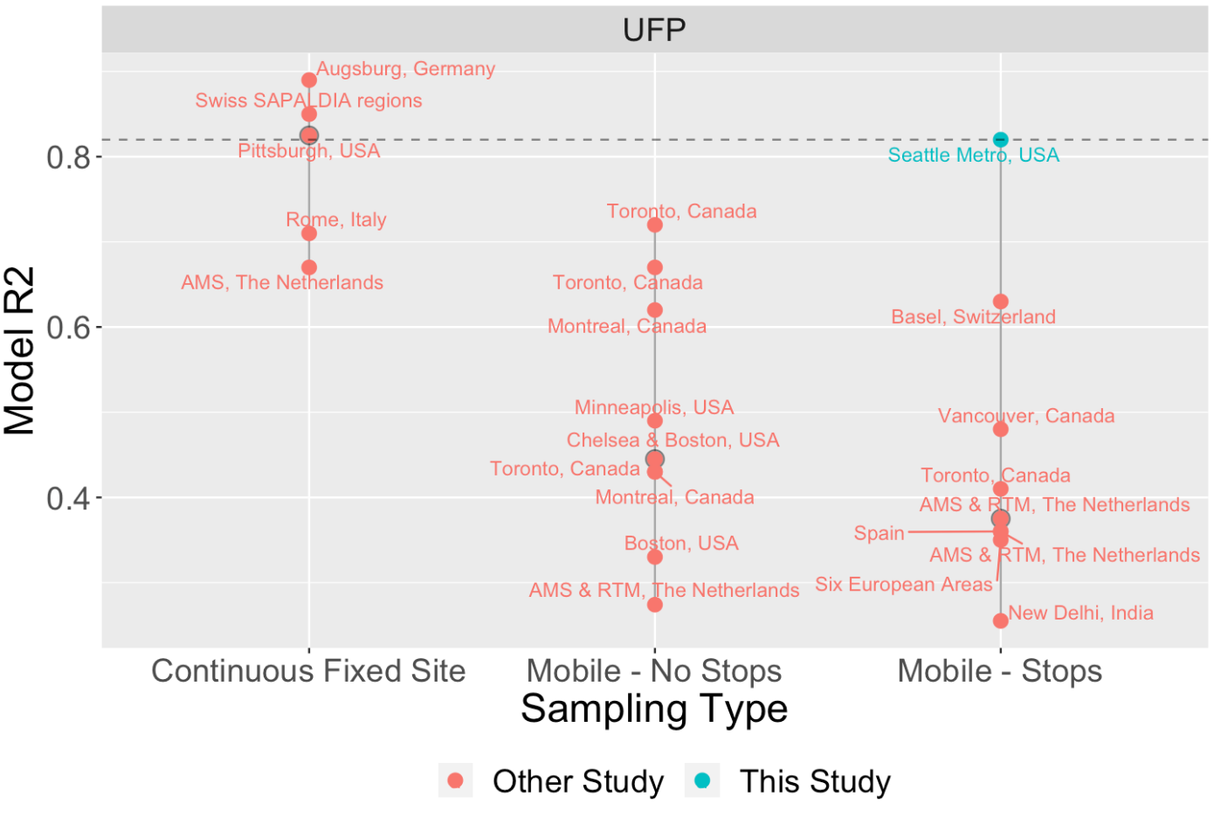
Model Performances
Higher R² model performance than similar studies
Similar for BC
Model performance from other UFP studies. Gray dot and vertical line are the median and range; this study is in blue; other studies are in red.
Notes:
high model performance is an important strength for TRAPs, which have strong decay patterns – models captured exposure surfaces well
We reported MSE-based CV R2. Others have likely reported an in-sample regression-based R2 (most did not state), which should perform better.

