Slide 1

Ultrafine Particles Near Airports
Professor Tim Larson
CEE, UW
December, 2016

Slide 2
Acknowledgements
UW
Michael G. Yost
Christopher D. Simpson
Erin Riley
Timothy R. Gould
Kris Hartin Sarunporn Booonyarattaphan
Jecca Canet
USC
Scott Fruin
Neelakshi Hudda

Slide 3
What are Ultrafine Particles?
Ultrafine Particles (UFPs)
ACI EUROPE UFP Study 2012
(https://www.cph.dk/contentassets/04a9b35237a547d1a924ea3c9df25c31/aci-europe-study-on-ultrafine-particles-at-airports.pdf )

Slide 4
Occupational exposures to UFP are known to be high in some settings.
A map of personal exposure concentrations for workers at the Copenhagen airport in Autumn of 2012 is shown at right.
Moller et al (2014) PLoS ONE 9(9): e106671, doi:10.137/journal.pone.006671

Slide 5
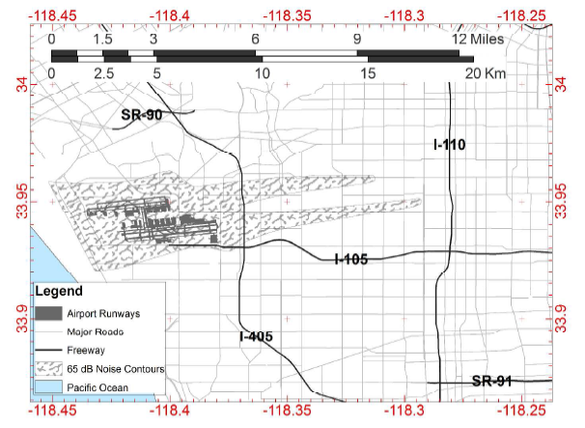
Sampling Routes near LAX
USC platform
UW platform
both
Hudda et al, 2014

Slide 6
Examining Local Background Values Reveals the Aircraft Impacts
Apply rolling 5th percentile of 1 second data using a 30 second window
This removes local scale impacts
Hudda et al, ES&T 2014

Slide 7
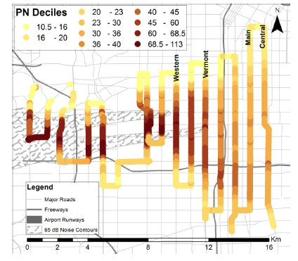
Area-weighted number concentration equivalent to ~ half the freeways in LA!
10³/cc
Hudda et al, ES&T 2014

Slide 8
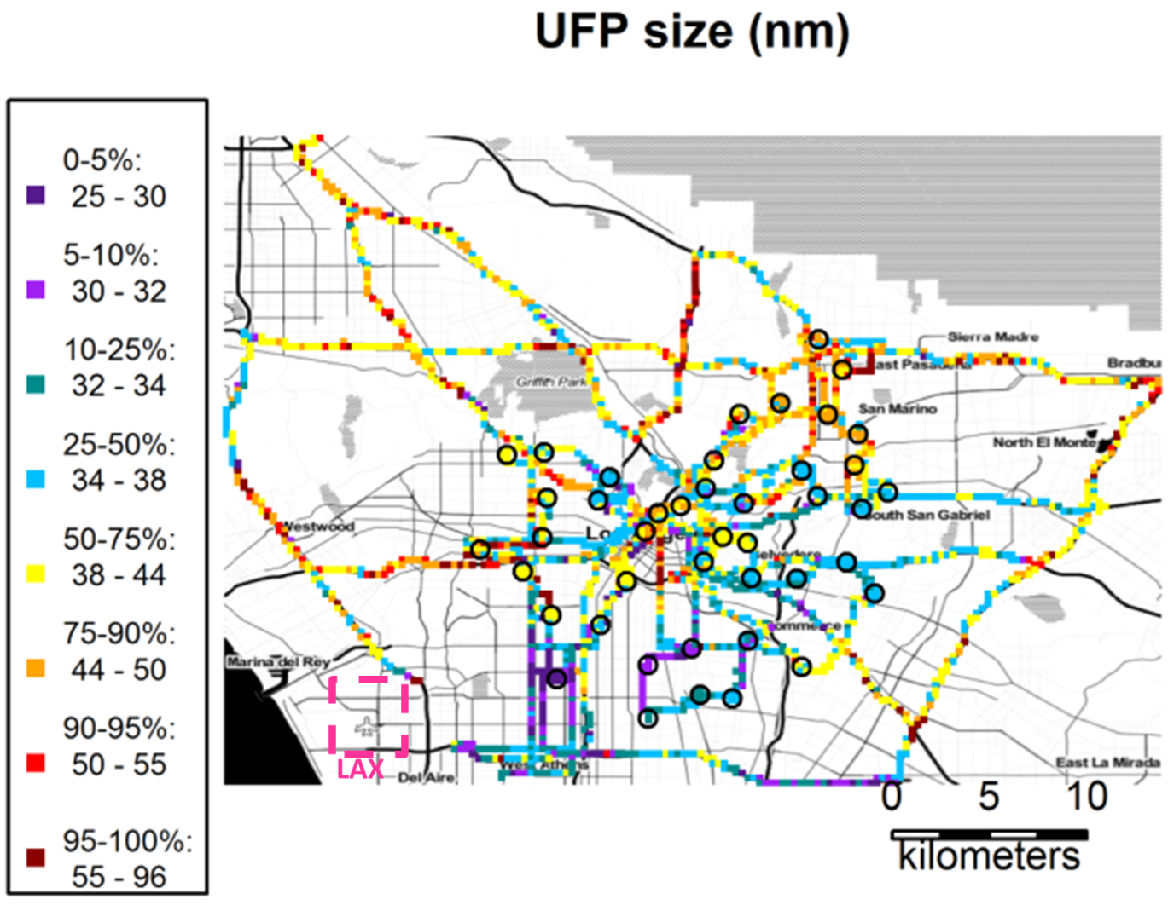
Particles between ~25 and 30 nm diameter reveal an extended plume downwind of LAX
nm
E.A. Riley et al Atm Env, 2016

Slide 9
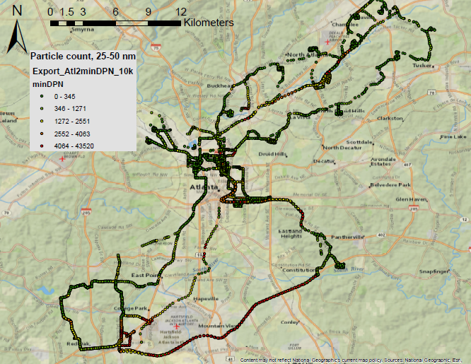
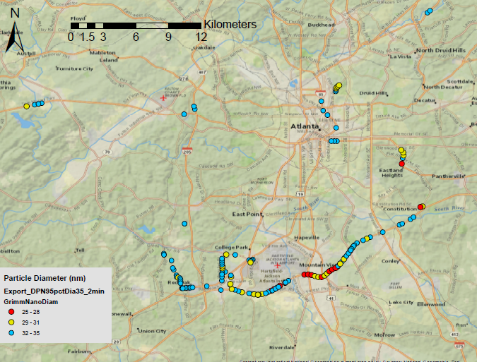
Airport-associated UFP Impacts Revealed Using a Combination of particle size and concentration
All mobile monitoring locations
ΔPN >daily 95th%; Particle size < 35 nm

Slide 10
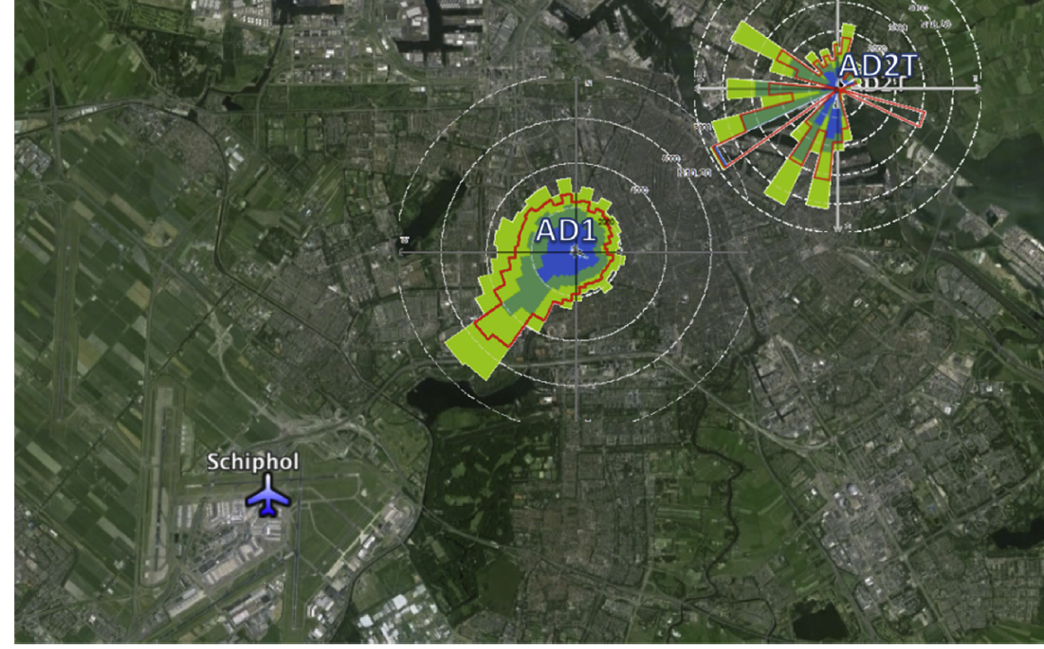
Elevated UFP concentrations observed at fixed locations 8 and 14 km downwind of Schiphol airport in Amsterdam.
Particles with diameters between 10 and 20 nm show higher number concentrations when the wind is coming from the airport
J. Hofman et al., Atmospheric Environment 136 (2016) 68-81

Slide 11
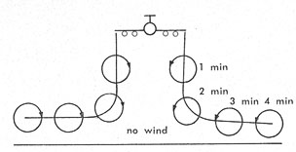
“Vortices generated below about 1500 feet usually sink to just above the ground, 50 to 100 feet. Their speed of descent varies with the type of aircraft and with the local atmospheric conditions. A figure of 450 feet per minute is typical of large sweptwing jet transports. As the vortices approach the ground, they spread apart and move sideways, at right angles to the runway, at the same 450 feet per minute, roughly 5 miles per hour.”
--Andrew S. Carten, Jr. (M.S., Tufts University) is Chief, Equipment Engineering and Evaluation Branch, Aerospace Instrumentation Laboratory, Air Force Cambridge Research Laboratories. Available: http://www.airpower.maxwell.af.mil/airchronicles/aureview/1971/jul-Aug/carten.html
https://www.flickr.com/photos/44073224@N04/

Slide 12

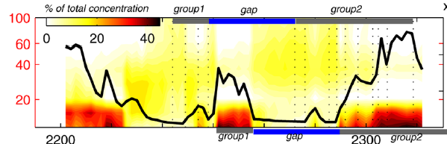

Particles between ~10 and 20 nm diameter are present in high concentrations at ground level ~3 km downwind of northern runway at LAX
9x10⁴
6x10⁴
PN Concentration
(number/cm³)
3x10⁴
10 min
(July 19,2004)
N Hudda and SA Fruin (2016) ES&T 50, 3362-3370.

Slide 13
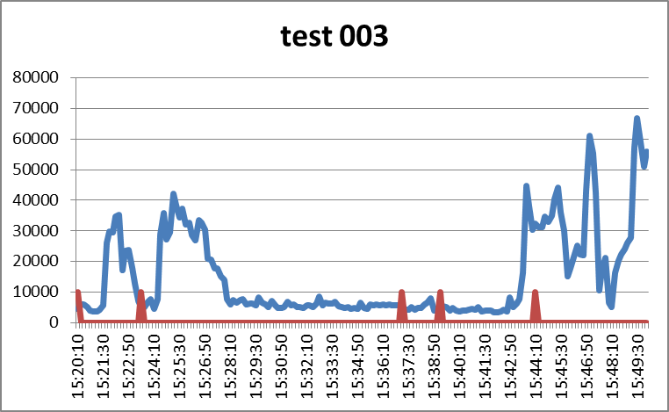
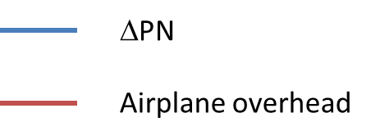
Elevated UFP levels observed ~1 km North of Sea-Tac Runway
ΔPN
(#/cc)

Slide 14
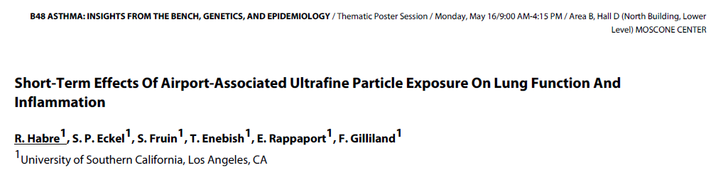
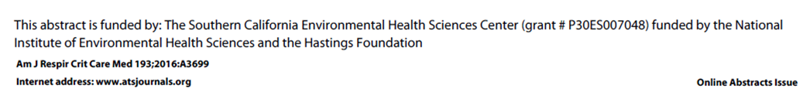
Randomized crossover study of 21 non-smoking adults with mild to moderate asthma
2-hr scripted, mild walking activity both inside and outside of the high LAX UFP impact zone (avg. difference ~30,000 /cc)
Mean particle size at LAX impact zone was 29 nm
Observed an increase in inflammatory blood markers and a reduction in lung function
“Preliminary data suggest a relationship between airport-related UFP exposures and adverse acute lung effects in asthmatics”

Slide 15
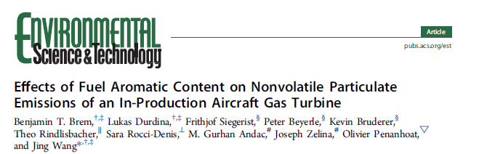
Aircraft Turbine Emissions are lower at lower engine thrust and at higher fuel hydrogen content.
DOI: 10.1021/acs.est.5b04167
Environ. Sci. Technol. 2015, 49, 13149−13157

Slide 16
Summary
Relatively high concentrations of Ultrafine particles less than~35 nanometers in diameter have been observed with 5km downwind of busy airports
A few studies have detected downwind ufp impacts up to 20 km downwind
The relative contribution of landings and take-offs versus on-site emissions to these extended downwind plumes has not been clearly established, although there is suggestive evidence that aircraft vortices may play an important role
Health effects studies of airport-associated ultrafine particles is very limited, with only one preliminary study found to date

Slide 18
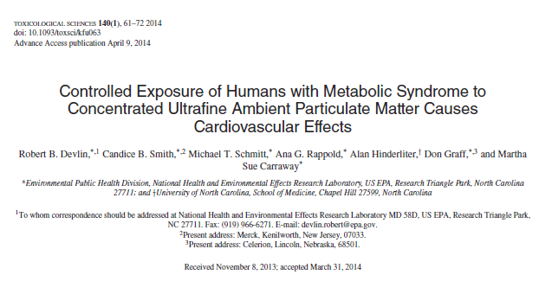
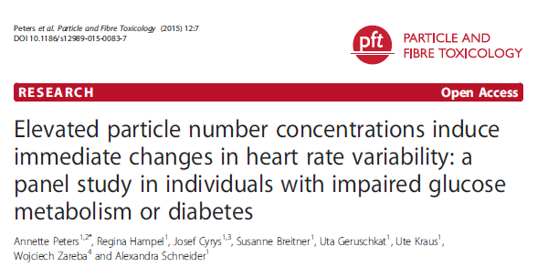
Recent Studies Suggesting Acute Health Effects in Susceptible Populations
Controlled Exposures to Concentrated Ambient Particles
Exposures Documented with Personal Monitors

